Slide 1
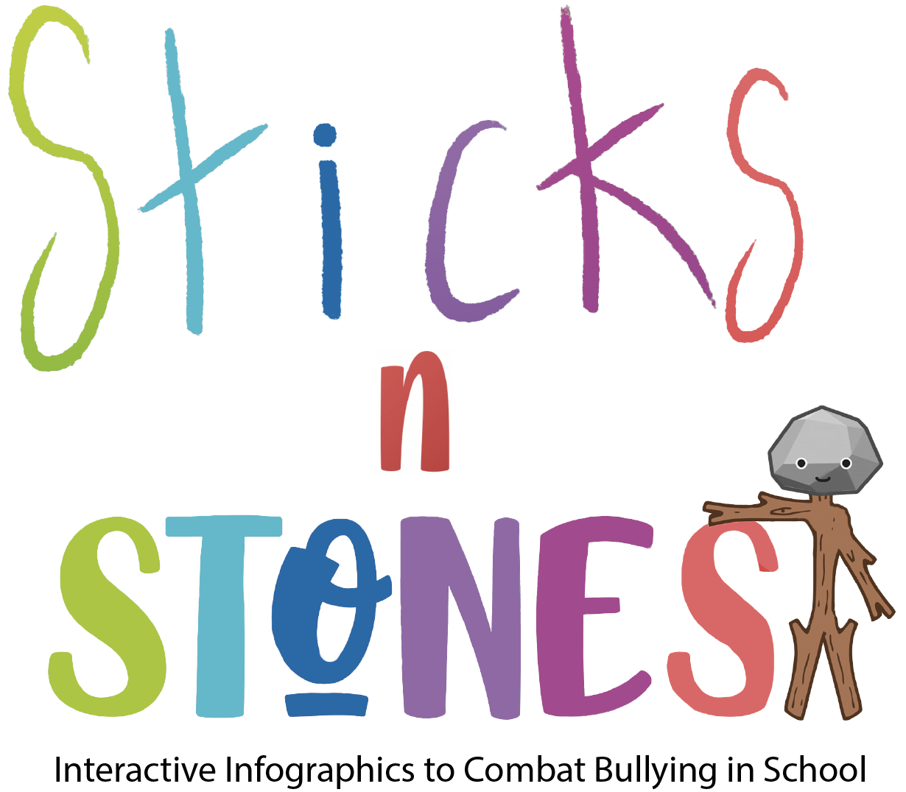
IO2: Module 2 F2f learning

Slide 2
Aim of Module 2

Slide 3
This module aims to introduce the didactic theory of challenge-based learning to primary school teachers and to include instructions and guidelines to be followed when developing their own challenge-based learning resources.
This module contains 3 main activities (or lessons): A2.1, A2.2, A2.3.

Slide 4
Structure of Module 1
Activity 2.1:
Challenge-Based Learning approach (CBL): introduction to it and theoretical aspects
Activity 2.2:
CBL’s key-implications for teaching and learning
Activity 2.3:
How to create CBL lesson plans and resources

Slide 5
Activity 2.1:
Challenge-Based Learning approach (CBL): introduction to it and theoretical aspects

Slide 6
A.2.1 Challenge-Based Learning approach (CBL): introduction to it and theoretical aspects
Defining CBL (1)
Challenge-Based Learning (CBL) is a framework and a pedagogical approach.
It has emerged from the “Apple Classrooms of Tomorrow—Today” (ACOT²) project initiated to identify the essential design principles of the 21st-century learning environment.
CBL framework is collaborative and hands-on, asking all participants (pupils, teachers, families and community members) to identify Big Ideas, ask good questions, identify and solve Challenges, gain in-depth subject area knowledge, develop 21st-century skills, and share their thoughts with the world.
Notes:
More about “Apple Classrooms of Tomorrow—Today” (ACOT²) at: https://www.challengebasedlearning.org/wp-content/uploads/2020/11/acot2_background.pdf

Slide 7
A.2.1 Challenge-Based Learning approach (CBL): introduction to it and theoretical aspects
Defining CBL (2)
CBL builds on the foundation of experiential learning and leans heavily on the wisdom of a long history of progressive ideas. The framework is informed by innovative ideas from education, media, technology, entertainment, recreation, the workplace, and society.
CBL is designed to be flexible, customizable and allow for multiple points of entry. The approach can connect and extend current practice, serve as the framework for specific capstone events during the school year, and act as an overarching institutional wide framework for decision making and learning.

Slide 8
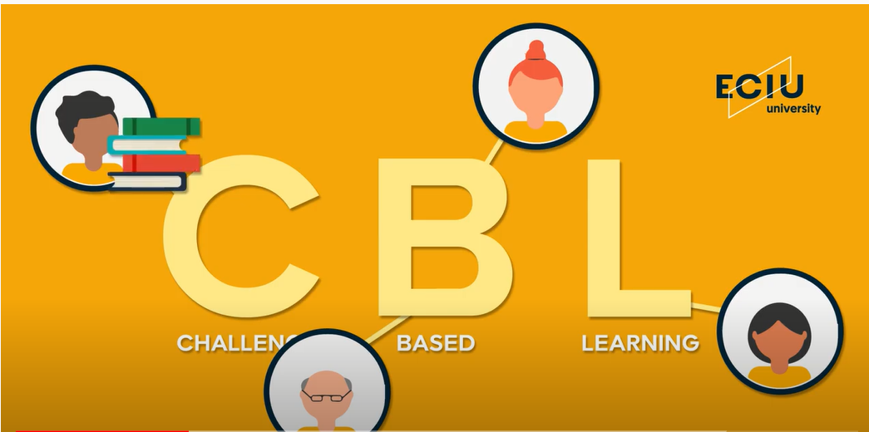
Task to do 1
Whole class activity: Reflection and Discussion
⮚ Watch the video at the link: https://www.youtube.com/watch?v=MyiFPIJivPY
⮚ Reflect and answer the question:
What did you understand CBL is, how you would define it in own words?
Working time: 15 minutes

Slide 9
A.2.1 Challenge-Based Learning approach (CBL): introduction to it and theoretical aspects
Describing CBL (1)
Key ideas/features at the foundation of CBL:
1. Teacher is Learner and Learner is Teacher: Ubiquitous access to information and technology provides the opportunity to break down the traditional hierarchical structure of schools and allows all participants to become both teachers and learners.
2. Moving beyond the four walls of the classroom. Involving all of the community members in the process expands resources, creates opportunities for authentic learning and moves the responsibility of education to the larger community.
3. Learner Inspired, Directed, and Owned. Meaningful connections are made between content and the lives of Learners.

Slide 10
A.2.1 Challenge-Based Learning approach (CBL): introduction to it and theoretical aspects
Describing CBL (2)
Key ideas/features at the foundation of CBL (continuation):
4. Challenges provoke: Situations or activities that create a sense of urgency and spur action.
5. Content and 21st century skills: Authentic learning experiences foster deep content knowledge and help Learners to organically develop a wide range of 21st century skills.
6. Boundaries of Adventure: Boundaries are provided to guide the way and provide freedom for Learners to take ownership of the process.

Slide 11
A.2.1 Challenge-Based Learning approach (CBL): introduction to it and theoretical aspects
Describing CBL (3)
Key ideas/features at the foundation of CBL (continuation):
7. Space and Freedom to Fail: A safe space is provided for all learners to think creatively, try new ideas, experiment, fail, receive feedback and try again. This iterative process is built into all of the phases of the framework.
8. Slowing for Critical and Creative Thinking: To ensure full participation and to provide opportunities for deep thinking, the learning process needs to be intentionally slowed down at times.
9. Authentic Use of Technology: Technology is used to research, communicate, organize, create, evaluate, document and persuade.

Slide 12
A.2.1 Challenge-Based Learning approach (CBL): introduction to it and theoretical aspects
Describing CBL (4)
Key ideas/features at the foundation of CBL (continuation):
10. Focus on Process and Product: The process of getting to the solution is valued as much as the solution.
11. Documentation and Storytelling: During each step of the challenge process, the learners document and publish using text, video, audio and pictures.
12. Reflection: Throughout the process, learners continuously reflect on the content and the process.

Slide 13
A.2.1 Challenge-Based Learning approach (CBL): introduction to it and theoretical aspects
CBL as….
CBL can be implemented in a variety of ways, and is designed to support other pedagogical approaches:
As a verb, CBL expresses a philosophical approach to planning, problem solving and learning.
For example: Let’s CBL it!
As a noun, CBL can be an event embedded in a learning experience or serve as a capstone experience for a course.
For example: At the end of the semester the pupils will participate in a challenge.

Slide 14
A.2.1 Challenge-Based Learning approach (CBL): introduction to it and theoretical aspects
CBL as….
A verb | A noun
A way of thinking. Becomes central to the philosophy of the institution. Organizes other educational approaches Organizes the curriculum Used at all levels: planning, organizing, teaching. Language permeates the institution | Is a challenge event (or series of events) Includes a finite time span Is another tool in the toolkit Is used during specified point of the program Is used for a specific purpose.

Slide 15
A.2.1 Challenge-Based Learning approach (CBL): introduction to it and theoretical aspects
Basic Principles of CBL (1)
As mentioned before, CBL was developed based on “Apple Classrooms of Tomorrow -Today” (ACOT²) .
ACOT² has identified six design principles for the 21st century high school.
Starting with these design principles, Apple Inc. worked with exemplary educators to develop and test Challenge-Based Learning.

Slide 16
A.2.1 Challenge-Based Learning approach (CBL): introduction to it and theoretical aspects
Basic Principles of CBL (2)
ACOT² six design-principles for the 21st century are:
1. Understanding of 21st Century Skills and Outcomes
2. Relevant and Applied Curriculum
3. Informative Assessment
4. A Culture of Innovation and Creativity
5. Social and Emotional Connections with Students
6. Ubiquitous Access to Technology
Notes:
Establishes as a baseline that educators, students and parents must be well versed in the 21st century skills that students need to acquire to be successful.
Offers an innovative vision of what the learning environment should become by applying what we know about how people learn and adapting the best pedagogy to meet the needs of this generation of learners.
Identifies the types and systems of assessments schools need to develop to fully capture the varied dimensions of 21st century learning as well as the independent role students need to take on in monitoring and adjusting their own learning.
Acknowledges that schools should create a culture that supports and reinforces innovation for student learning and leverages the creativity and ingenuity of every adult and student to solve their unique problems.
Gives appropriate recognition to the personal, professional, and familial relationships that determine the health, growth, and cognitive development of a child within the family, school, and community.
Underscores the essential role technology plays in 21st century life and work and, consequently, the role that it must play in learning. Students and educators need 24 by 7 access to information, resources, and technologies.

Slide 17
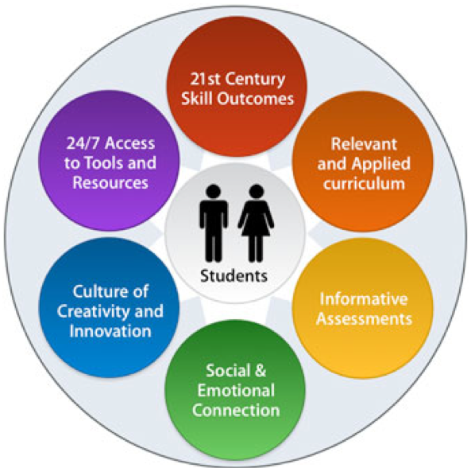
A.2.1 Challenge-Based Learning approach (CBL): introduction to it and theoretical aspects
Basic Principles of CBL (3)
Source: http://survivaleducation.blogspot.com/2010/03/acot2-has-identified-six-design.html
Notes:
More info at: https://edusol.info/historico/bitacora/eraser/acot2-apple-classroomms-tomorrow-today

Slide 18
Task to do 2
Discussion (the whole class is engaged; the trainers moderates discussion)
Have you used PBL or CBL in your classroom or school? Tell us about your experiences!
Working time: 15 minutes

Slide 19
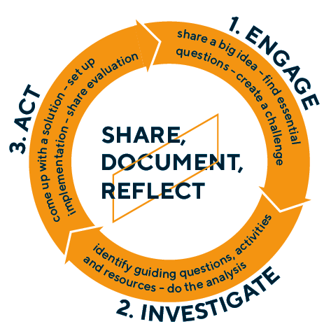
A.2.1 Challenge-Based Learning approach (CBL): introduction to it and theoretical aspects
Phases of CBL
The Challenge-Based Learning Framework is divided into three interconnected phases:
1. Engage (in which the learners move from an abstract Big Idea to a concrete and actionable Challenge),
2. Investigate (in which learners conduct Research to create a foundation for actionable and sustainable solutions) and
3. Act (in which evidence-based Solutions are developed and implemented with an authentic audience and the results evaluated).

Slide 20
A.2.1 Challenge-Based Learning approach (CBL): introduction to it and theoretical aspects
Summary of CBL
Big Idea + Challenge
ENGAGE 🡪 Essential Question
INVESTIGATE 🡪 Guiding Questions / Guiding Activities / Resources
Synthesis
Solution Prototypes
Solution
ACT 🡪 Implement + Evaluate
Reflect, Document, Share

Slide 21
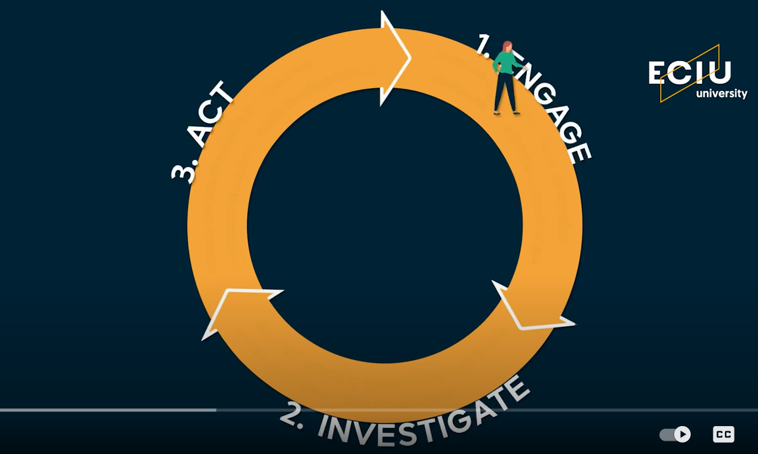
A.2.1 Challenge-Based Learning approach (CBL): introduction to it and theoretical aspects
More about the CBL phases or CBL in practice…
Let’s watch together this short video:
https://www.youtube.com/watch?v=CFCSvvsPWUA
Do you feel more prepared now to apply CBL?
(reflective question, trainees do not need to answer…)

Slide 22
A.2.1 Challenge-Based Learning approach (CBL): introduction to it and theoretical aspects
About the Challenge…
A Challenge is immediate, actionable and builds excitement.
Choosing and setting up the Challenge is crucial. If it is interesting and sufficiently close to home, pupils will derive personal meaning and feel a sense of accomplishment upon understanding the content, proposing and implementing a Solution.
If the Challenge is too broad or vague, the pupils will struggle. If it is too narrow, they will not be able to experience the self-direction that is required to develop the skills that CBL cultivates.
Challenges should be difficult and have multiple possibilities for Solutions, as well as organized and scaffolded to support the Learners.

Slide 23
A.2.1 Challenge-Based Learning approach (CBL): introduction to it and theoretical aspects
About the amount the time the pupils have to work on the Challenge…
Some Challenges can be addressed in a day or a week, while others need a semester or even an entire school year.
If the Challenge is too big for the allotted time, the pupils will feel pressured or frustrated. If it is too small, they will lose interest.
It is important for the Challenge to be real and meaningful to the pupils. If a Challenge is contrived or something that the pupils cannot personally connect with, they will not fully engage in the process!

Slide 24
A.2.1 Challenge-Based Learning approach (CBL): introduction to it and theoretical aspects
Types/variations of Challenges
CBL is designed to be flexible, customizable and allow for multiple points of entry.
In considering CBL, think about how the framework fits with personal and institutional learning goals and how it can be implemented and supported.
Challenges create a sense of urgency and spur action. In CBL, they include a specific structure (Engage, Investigate and Act), vary in duration and intensity and can be incorporated or adapted to most learning environments.
Types/variations of Challenges include:
1. Nano Challenges
2. Mini Challenges
3. Standard Challenges
4. Capstone Challenges
5. Strategic Challenges
Notes:
More about variations of Challenges at: https://www.challengebasedlearning.org/wp-content/uploads/2019/02/CBL_Guide2016.pdf

Slide 25
A.2.1 Challenge-Based Learning approach (CBL): introduction to it and theoretical aspects
Comparison between CBL and PBL (1)
Problem-Based Learning (PBL) starts, as the name suggests, with a problem.
In this model, pupils are presented with an open-ended problem. They must search through a variety of resources, called trigger material, to help them understand the problem from all angles.
Between CBL and PBL there more differences than common points.
Let’s make a comparison between the two learning approaches!

Slide 26
A.2.1 Challenge-Based Learning approach (CBL): introduction to it and theoretical aspects
Comparison between CBL and PBL (2)

Slide 27
A.2.1 Challenge-Based Learning approach (CBL): introduction to it and theoretical aspects
Comparison between CBL and PBL (3)
Source: https://www.researchgate.net/publication/320443042_Challenge_Based_Learning_VS_Problem_Based_Learning

Slide 28
A.2.1 Challenge-Based Learning approach (CBL): introduction to it and theoretical aspects
Resources and activities for CBL (1)
During the CBL, the learners will need Guiding Activities and Resources (especially in the ‘Investigate!’ phase). These will be used to answer the learners’ Guiding Questions.
Resources can include:
online databases and journals
online courses
the school or public library
Social networks
local experts or experts located anywhere in the world via the web

Slide 29
A.2.1 Challenge-Based Learning approach (CBL): introduction to it and theoretical aspects
Resources and activities for CBL (2)
Guiding Activities can include:
Simulations
Experiments
Projects
Problem sets
Research
Games
Expert interviews
Surveys
Lectures,
Textbook
Assignments
Any resource or activity that helps uncover the knowledge needed to answer the Guiding Questions and to develop an innovative, insightful and realistic Solution is valuable!

Slide 30
Task to do 3
Example of CBL:
⮚ Work in pairs (the trainer will help organising the pairs)
⮚ Access https://www.challengebasedlearning.org/project/big-idea-respect/
⮚ Read the CBL example provided there (Big Ideas: RESPECT)
⮚ Reflect on how would you implement this CBL lesson with pupils aged 8-12
⮚ Adapt the element of this CBL lesson to pupils aged 8-12 (the Essential and Guiding Questions, the Activities and Resources)
⮚ Share your ideas with your pair and ask him/her to do the same; if there are big differences between your two, each of you offer the other arguments and explanations
Working time: 30 minutes

Slide 31
References
1. Challenge-Based Learning, https://www.challengebasedlearning.org/about/
2. CBL principles, https://edusol.info/historico/bitacora/eraser/acot2-apple-classroomms-tomorrow-today
3. Challenge-Based Learning, https://www2.tuhh.de/zll/cbl-start/
4. CBL Guide 2016, https://www.challengebasedlearning.org/wp-content/uploads/2019/02/CBL_Guide2016.pdf
5. Esraa Mohammed Soltan (2015), Challenge Based Learning vs. Problem Based Learning, Research Gate, https://www.researchgate.net/publication/320443042_Challenge_Based_Learning_VS_Problem_Based_Learning
6. Challenge Based Learning, https://www.kalinda.vic.edu.au/page/78/Challenge-Based-Learning

Slide 32
Activity 2.2:
CBL’s key-implications for teaching and learning

Slide 33
A.2.2 CBL’s key-implications for teaching and learning
What are the key-implications of CBL on teaching and learning? (1)
PBL is based in the constructivist theory and is centred around John Dewey’s “learning by doing.”
Constructivist theory says that learning is done by constructing, creating, inventing, and developing our knowledge (Marlowe & Page, 1998).
PBL is thus a way for learners to build their knowledge through a specific task rather by than passively receiving the information from the teacher.
(Chris L. Swiden, Effects of Challenge-Based Learning on Student Motivation and Achievement,)

Slide 34
A.2.2 CBL’s key-implications for teaching and learning
What are the key-implications of CBL on teaching and learning? (2)
One of the key elements of CBL is its use of technology to implement solutions and to publish results, obliging learners to present their findings and reflections not just to their class but also to their community.
This broader audience improves engagement and allows learners wider avenues for success. In addition to whatever is learned about the chosen topic, learners gain meaningful skills through CBL projects, including how to share work, collaborate, organize and express themselves more effectively.
Learners garner these valuable takeaways even if the project itself is not successful. The CBL approach may thus serve as a confluence point for changes in teaching and learning, bringing in aspects of experiential learning, multimedia technology, social interaction, and a willingness to look beyond the walls of the classroom for educational opportunities.

Slide 35
A.2.2 CBL’s key-implications for teaching and learning
Why is CBL significant? (1)
In a practical sense, CBL activities offer many of the benefits of project-based learning, as they engage learners in real-world problems and make them responsible for developing solutions.
Additionally, learners have the satisfaction that comes from figuring out both the issue to be tackled and the solution they develop.
Because the CBL projects are generally community based, individual learners might reap the rewards of social and educational/professional interaction, while their institutions might benefit from enhanced community-school/campus relations.

Slide 36
A.2.2 CBL’s key-implications for teaching and learning
Why is CBL significant? (2)
As participants determine where a problem lies, how a solution might be effected, and how technology can be leveraged to accomplish a workable result, they learn the value of critical thinking and reflection.
The payoff in learner engagement and satisfaction can be high.
In Apple’s 2008 study of CBL, findings showed learner engagement among participating ninth and tenth graders was rated at 97% or higher and that learner involvement peaked where they perceived the solutions they worked on to be of real value.

Slide 37
Task to do 4
Individual work
The 6 Word Story:
⮚ Using only six words, express your view of CBL benefits on learning.
⮚ Share this view with the class when the trainer nominates you and justify it with arguments.
Working time: 25 minutes

Slide 38
A.2.2 CBL’s key-implications for teaching and learning
What are the benefits of CBL for learning? (1)
Many studies and research in America and around the world have found that CBL is beneficial for learners through the learning processes it activates, the results it provides and the skills it acquires in learners.
It has been proven that CBL:
increases student engagement
develops skills development
supports content mastery.

Slide 39
A.2.2 CBL’s key-implications for teaching and learning
What are the benefits of CBL for learning? (2)
More benefits that CBL offers are:
establishing new teaching and learning practices which are aligned with work-life environments;
increasing employability for students;
(as an authentic learning experience), allowing students to explore, discuss, and meaningfully construct concepts and relationships in contexts that involve real-life challenges and projects that are relevant to the learner.

Slide 40
A.2.2 CBL’s key-implications for teaching and learning
What are the benefits of CBL for learning? (3)
CBL benefits span over major educational aspects:
High-level communication skills
Addressing a broad curriculum
Access to wide range of technology and resources

Slide 41
A.2.2 CBL’s key-implications for teaching and learning
What are the benefits of CBL for learning? (4)
High-level communication skills
A key feature of challenge-based learning is that it appropriates the networking tools and media production techniques already being used in daily life by many 21st century learners. In preparing the final products of their research — presentations of their chosen solutions — students draw upon photography, videography, audio recording, and writing skills that they may already be using as web content producers.
If they are not already doing those things, challenge-based learning provides an engaging opportunity for them to hone these kinds of high-level communication skills.

Slide 42
A.2.2 CBL’s key-implications for teaching and learning
What are the benefits of CBL for learning? (5)
Addressing a broad curriculum
Because CBL takes its ideas from real-world issues that learners then must translate into solutions of local applicability, a very wide range of curricular areas can be addressed.
When integrated as a regular part of the curriculum, CBL practices naturally lead to discovery of relevant subject matter in many areas. Because problems do not need to be invented — the challenges are real — learners connect what they are learning with their own experiences.

Slide 43
A.2.2 CBL’s key-implications for teaching and learning
What are the benefits of CBL for learning? (6)
Access to wide range of technology and resources
Access to technology, an integral part of CBL, can help teachers overcome some of the other constraints of problem-based learning.
Ubiquitous Internet access in a one-to-one setting opens the door for learners to use online tools for collaboration and communication, often the same tools that are used in the modern workplace. Learners have access to a wider range of resources, including current news articles, research and even experts around the world.

Slide 44
A.2.2 CBL’s key-implications for teaching and learning
What are the benefits of CBL for learning? (7)
Last but not least:
CBL motivates learners to come to class and do well.
It leverages technology tools to put the daily experiences of learners in the service of their education.
It focuses learning on real-world issues, gives learners a chance to work on important problems, gets their voices heard and empowers them to influence their community for the better.
CBL has real potential to reverse the slipping trend of poor retention, low scores, and disengagement, turning learning into an exciting, meaningful experience — as it is meant to be.

Slide 45
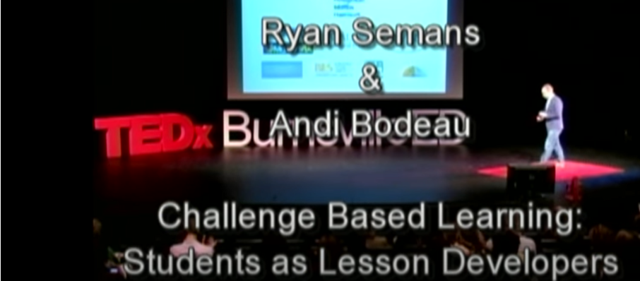
Task to do 5
Individual work and pairs work: Letter to Community
⮚ Watch the video “Challenge based learning: Andi Bodeau and Ryan Semans” at TEDx Talks, at the link: https://www.youtube.com/watch?v=yv1E6Vth7Uw
⮚ Reflect on the video and on what the trainer presented so far and:
Write one-page letter to the teachers’ community, sharing your thoughts and feelings about CBL and what it brings to pupils to make education better. What would you like to see changed in teaching practices through CBL? What would it mean to you to see these things change? Can you get involved, can you contribute to the change from traditional teaching-learning to challenge-based learning?
⮚ When finished, pair with another trainee, exchange your letters, read them reciprocally and discuss your views.
Working time: 50 minutes

Slide 46
A.2.2 CBL’s key-implications for teaching and learning
What are the downsides of CBL? (1)
For both learners and teachers, CBL requires a heavier time commitment than more traditional teaching-learning activities.
The model requires teachers to guide learners in classroom discussion while giving up part of their usual control, sometimes allowing learners to make errors that they can uncover for themselves later.
There may be concerns, too, that learners will select topics about which the teacher knows little or that learners might choose to use technologies that go beyond the teacher’s expertise.

Slide 47
A.2.2 CBL’s key-implications for teaching and learning
What are the downsides of CBL? (2)
It can also be tricky to integrate core competencies of a course/lesson into the content of the chosen project.
Add to these difficulties the need to shepherd learners successfully through interaction with community members, and demands on a teacher can be substantial.
Moreover, traditional methods of assessment might prove inappropriate for measuring what learners learn in a challenge-based project.

Slide 48
Task to do 6
Work in groups: Devil's Advocate
⮚ Create 2 groups (the trainer will help you organise the groups)
⮚ The groups will implement the Devil's Advocate technique, in which a group plays the ‘devil’, the other group is the devil’s opponent and combats the devil’s ideas (the trainer will nominate who is who); both groups will have to sustain their ideas with arguments.
⮚ First, each group separately analyses the statement:
“CL does not support school performance and is not beneficial to students.”
and prepares its ideas and arguments according to the role assigned to it.
Working time: 15 minutes
⮚ Then, the two groups confront: the ‘devil’ advocates in favour of the above statement for the sake of argument or also with the purpose to expose it to a thorough examination. Its opponent brings arguments to demolish the above statement and convince the devil he is wrong.
Working time: 15 minutes

Slide 49
References
1. Things You Should Know About…Challenge-Based Learning, https://library.educause.edu/-/media/files/library/2012/1/eli7080-pdf.pdf
2. Chris L. Swiden (2013), Effects of Challenge-Based Learning on Student Motivation and Achievement, A professional paper submitted in partial fulfillment of the requirements for the degree of Master of Science in Science Education, Montana State University, Bozeman, Montana, p.9
3. Webinar „The Benefits of Challenge-based Learning”, 25 January 2021, https://www.nyas.org/events/2021/webinar-the-benefits-of-challenge-based-learning/?tab=description
4. Challenge-Based Learning, https://www2.tuhh.de/zll/challenged-based-learning/
5. Johnson, Laurence F.; Smith, Rachel S.; Smythe, J. Troy; Varon, Rachel K. (2009). Challenge-Based Learning: An Approach for Our Time. Austin, Texas: The New Media Consortium, p. 9
6. Tedx talks, “Challenge based learning: Andi Bodeau and Ryan Semans”, https://www.youtube.com/watch?v=yv1E6Vth7Uw

Slide 50
Activity 2.3:
How to create CBL lesson plans and resources

Slide 51
A.2.3 How to create CBL lesson plans and resources
How to create CBL lesson plans (1)
The Challenge –Based Learner User Guide (2016) elaborated by “Digital Promise and The Challenge Institute” teaches us how to design and implement CBL with learners of all ages (from young graders in primary schools, to university students or beyond), in various types and forms of educations (formal education, VET, adult education, entrepreneurial education, community education, etc.).
The Guide is for everyone students, teachers, parents, administrators and community members) interested in building learning communities focused on identifying Challenges and implementing thoughtful and sustainable solutions.

Slide 52
A.2.3 How to create CBL lesson plans and resources
How to create CBL lesson plans (2)
The Guide is organized into four sections:
1. An overview of key concepts, the updated framework and ideas about implementation.
2. Recommendations and resources to support the use of CBL.
3. An in-depth walkthrough of the framework with examples, tips, and best practices.
4. The final section includes connections with other educational approaches to assist with decision making and integration, and a list of frequently asked questions.
So, when you start creating a CBL lesson plan, make sure that you have read and understood the Guide and that you follow correctly all CBL framework steps!

Slide 53
A.2.3 How to create CBL lesson plans and resources
How to create CBL lesson plans (3)
Lets’ follow the CBL Guide….
Before doing that, we remind you that the CBL approach is different from traditional one, from problem-based learning or project-based learning….so, the CBL lesson plan does not look like a traditional lesson plan!
You remember the 3 phases of CBL:
Phase 1: ENGAGE
Phase 2: INVESTIGATE
Phase 3: ACT
We will explain what you need to plan and do for each of these stages, when creating a CBL lesson plan….

Slide 54
A.2.3 How to create CBL lesson plans and resources
How to create CBL lesson plans (4)
Phase 1: ENGAGE
Through a process of Essential Questioning, the Learners move from an abstract Big Idea to a concrete and actionable Challenge.
1. Big Ideas are broad concepts that are explored in multiple ways and are relevant to the Learners, and the larger community (e.g. health).
2. Essential Questioning allows the Learners to contextualize and personalize the Big Idea. The end product is a single Essential Question that is relevant to the individual or group (e.g. What do I need to do to be healthy?).
3. Challenges turn the Essential Questions into a call to action by charging participants to learn about the subject and develop a Solution. Challenges are immediate and actionable.

Slide 55
A.2.3 How to create CBL lesson plans and resources
How to create CBL lesson plans (5)
Phase 2: INVESTIGATE
All Learners plan and participate in a journey that builds the foundation for Solutions and addresses academic requirements.
1. Guiding Questions point towards the knowledge the Learners will need to develop a Solution to the Challenge. Categorizing and prioritizing the questions create an organized learning experience. Guiding Questions will continue to emerge throughout the experience.
2. Guiding Activities and Resources are used to answer the Guiding Questions developed by the Learners. These activities and resources include any and all methods and tools available to the Learners.
3. Analysis of the lessons learned through the Guiding Activities provides a foundation for the eventual identification of Solutions.

Slide 56
A.2.3 How to create CBL lesson plans and resources
How to create CBL lesson plans (6)
Phase 3: ACT
Evidence-based Solutions are developed, implemented with an authentic audience, and then evaluated based on the results.
1. Solution concepts emerge from the findings made during the investigation phase. Using the design cycle, the Learners will prototype, test and refine their Solution concepts.
2. Implementation of the Solution takes place within a real setting with an authentic audience. The age of the Learners and the amount of time and resources available will guide the depth and breadth of the implementation.
3. Evaluation provides the opportunity to assess the effectiveness of the Solution, make adjustments and deepen subject area knowledge.

Slide 57
Task to do 1
Whole class work: Discussion
How do you feel now, having all the information and details you received on CBL, about implementing CBL with your pupils?
Would you feel confident and comfortable with the CBL approach?
Do you (really) intend to apply CBL in your class in the near future?
Justify your answers….
Working time: 15 minutes

Slide 58
A.2.3 How to create CBL lesson plans and resources
How to create CBL lesson plans (7)
Before diving deeper into CBL, some thinking about planning and preparation is necessary!
CBL is unique in that most of what is considered "teacher work“ in traditional settings (e.g. determining learning goals, writing curriculum, researching content, aligning standards, and developing assessments) is completed with the students during the Challenge experience. Success with CBL necessitates providing structure, support, checkpoints and the right tools to get work done, while still allowing space for self-directed, creative, and inspired learning!

Slide 59
A.2.3 How to create CBL lesson plans and resources
How to create CBL lesson plans (8)
In CBL, schools, teachers, and students have different roles than in more traditional approaches to teaching and learning:
Schools: evolve from being information repositories to creative environments where all Learners can acquire real-world knowledge, address real-world Challenges, and develop skills they can use to solve complex problems for the rest of their lives.
Teachers: become more than information experts, they become collaborators/co-learners in learning, who leverage the power of students, seek new knowledge along side students, and model positive habits of mind and new ways of thinking and learning. The role of the teacher in CBL is to find the Solutions with the students, not for them.
Students: focus on each discrete part of the CBL process (but as the “senior Learner”, you will help them identify the learning goals and curriculum standards, create plans and manage their time). Over time, the students will take on more and more responsibility and ownership over the learning process.

Slide 60
A.2.3 How to create CBL lesson plans and resources
How to create CBL lesson plans (9)
What to have in focus:
(a) Survey of Big Ideas: Individuals or teams identify and research Big Ideas and develop reports or presentations.
(b) Challenge Proposal: Teams produce a document, video or presentation that defines the Big Idea, the Essential Question, the Challenge and why the Challenge is significant. The proposal is presented as a compelling invitation to others to join them in a quest to understand and identify Solutions.
(c) Guiding Questions: Once the Challenge is determined, Learners generate sets of questions that will guide the search for a Solution. The sets of questions should be
extensive, categorized and prioritized.
(d) Learning Plans and Timeline: A comprehensive plan to answer the Guiding Questions will ensure a thorough and organized learning experience as the Learners develop the foundation for a Solution. The Learners can also demonstrate an understanding of applicable standards through reports or presentations.

Slide 61
A.2.3 How to create CBL lesson plans and resources
How to create CBL lesson plans (10)
What to have in focus:
(e) Research Reports: During the Investigation phase, Learners can develop research or position papers to demonstrate their knowledge of the content. These can be traditional laboratory reports, research papers and short policy briefs.
(f) Solution Proposals/Design Briefs: Using the research reports, the Learners create presentations proposing a solution that include prototypes, concepts and initial feedback from focus groups and outside experts.
(g) Implementation and Evaluation Plans: The development of the Solution leads to an implementation and evaluation plan. The plan includes an in-depth description of the Solution, strategies, the stakeholders, and how success will be measured.
(h) Evaluation Results: The Learners develop reports from data gathered during the Implementation. If time allows, the Learners can develop plans for Solution improvement based on the results of the evaluation.

Slide 62
A.2.3 How to create CBL lesson plans and resources
How to create CBL lesson plans (11)
What to have in focus:
(i) Final Presentations: After the Solutions have been Implemented and Evaluated, the Learners can report the entire story. This document or video includes information about the group, a statement of the Challenge, why the Challenge is significant in their particular context, what was learned, the Solution, implementation, and evaluation process, and whether it was a success.
(j) Journals: Throughout the experience, students document their personal and group experience through written or video journals. You will want to make sure that you can access the journals to track progress and include them as part of the evaluation process.
(k) Final Reflection Videos: At the conclusion of the experience, the Learners reflect on what they learned about the content, process, and overall experience. Providing a series of prompts will allow the Learners to organize and present their ideas in a concise manner.
(l) Portfolios: The products created throughout the project are excellent resources for the development of portfolios that provide evidence of learning and can evolve into presentation portfolios for external audiences.

Slide 63
A.2.3 How to create CBL lesson plans and resources
How to create CBL lesson plans (12)
You have to plan also the ASSESSMENT!
In CBL the process and product is measured with both conventional and real world assessment methods. The assessments should inform decision making as the Learners move towards a Solution and provide feedback on the effectiveness of their efforts and depth of their content knowledge.
In deciding how to assess the process and products, place appropriate emphasis on three areas:
content knowledge and understanding
mastery of real-world skills and
the process of Challenge Based Learning.
In the next slide you have an example of CBL assessment rubric from Challenge Based Learning organisation.

Slide 65
A.2.3 How to create CBL lesson plans and resources
How to create CBL lesson plans (13)
In more concrete words, here there are examples of:
Essential Questions connected to Big Ideas
Big Idea: Community
Essential Question: How do we build supportive communities?
Big Idea: Relationships
Essential Question: How can we improve relationships between groups in our school?
Big Idea: Big Idea: Health
Essential Question: What is a healthy lifestyle?

Slide 66
A.2.3 How to create CBL lesson plans and resources
How to create CBL lesson plans (14)
In more concrete words, here there are examples of:
Challenges drawn from the Essential Questions connected to Big Ideas
Big Idea: Community
Essential Question: How do we build supportive communities?
Challenge: Build a supportive community!
Big Idea: Relationships
Essential Question: How can we improve relationships between groups in our school?
Challenge: Improve relationships in our school!
Big Idea: Creativity
Big Idea: Big Idea: Health
Essential Question: What is a healthy lifestyle?

Slide 67
A.2.3 How to create CBL lesson plans and resources
How to create CBL lesson plans (15)
In more concrete words, here there are examples of:
Guiding Questions for the Health Challenge:
What does it mean to be healthy?
What is the biology of health?
What factors influence health?
What are the major health issues in the world, my community and my family?
What is the role of nutrition?
What is the role of exercise?
What is the role of genetics?

Slide 68
A.2.3 How to create CBL lesson plans and resources
How to create CBL lesson plans (16)
In more concrete words, here there are examples of:
Guiding Resources: online databases and journals, online courses, the school or public library, social networks, local experts or experts located anywhere in the world via the web.
Guiding activities: simulations, experiments, projects, problem sets, research, games, expert interviews, surveys, lectures, and textbook assignments.
Any resource or activity that helps uncover the knowledge needed to answer the Guiding Questions and to develop an innovative, insightful, and realistic Solution is valuable!
In the Health Challenge example, resources and activities might include interviews with physicians, research using online databases and participation in an online course about nutrition.

Slide 69
A.2.3 How to create CBL lesson plans and resources
How to create CBL lesson plans (17)
There is no ‘standard’ lesson plan template for CBL, so any form you might create would be useful and is accepted! It only has to serve your needs when planning / designing a CBL lesson with your pupils!
However, experts (e.g. from Apples for Kids, Rise project of Challenge Institute) provides canvas and templates that any teacher can use or adapt for CBL lessons! They are presented in the next slides!
Keeping organized and documenting your process is critical for successfully completing the Challenge experience. It is particularly important to have a place where you can see progress and make decisions. Making the learning process visible throughout the Challenge experience helps to develop collaboration and innovation.

Slide 71
A.2.3 How to create CBL lesson plans and resources
How to create CBL lesson plans (18)
In the previous slide it is a planner (diagram) from Appels for Kids.
The top half of the diagram outlines the CBL framework as it is. The only difference here is that there have been included some overlapping of the stages, as there are times when students need to move back and forward between them.
The bottom half outlines more explicitly teacher involvement in the process. The hope is that this diagram outlines to teachers the ongoing opportunities to gather evidence of learning, explicitly teach, work with small groups and gather assessments.
This diagram is a visual way to highlight to teachers and students the different stages of the process, how they relate to one another and their role within them.
You can use its upper part as a starting point in creating a CBL lesson plan and the lower part to collect evidences after the implementation of your CBL lesson!

Slide 72
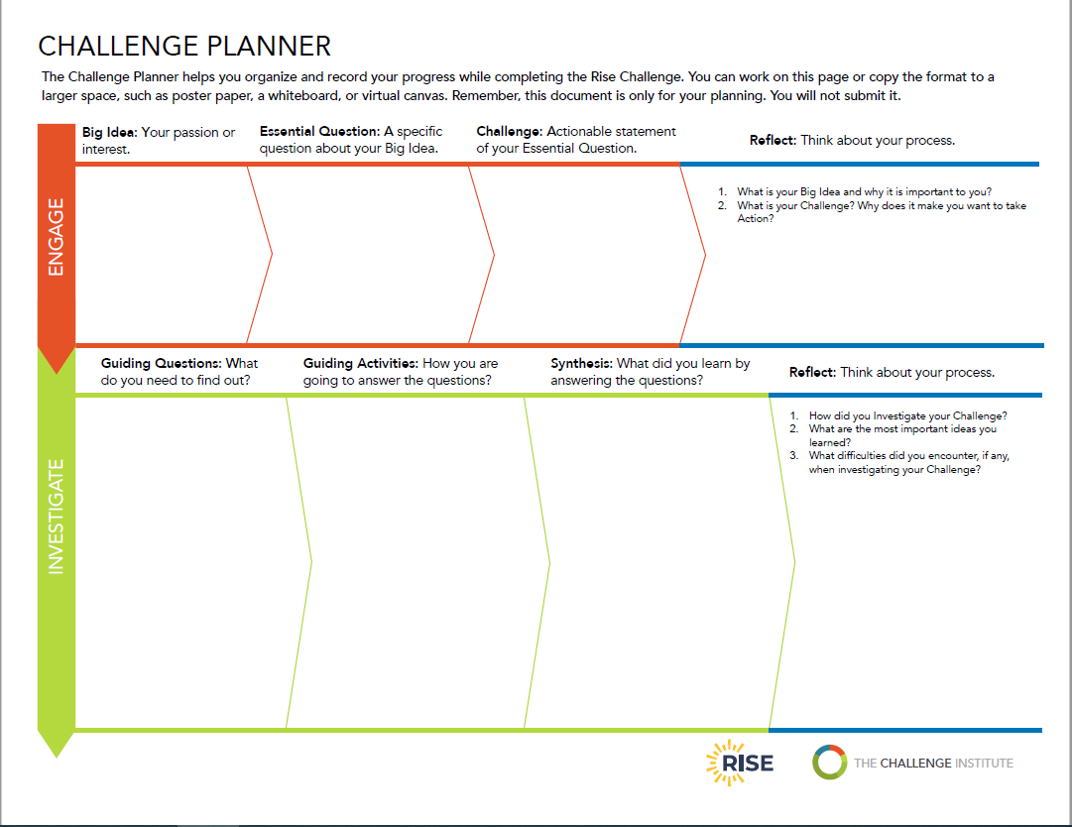

Slide 74
A.2.3 How to create CBL lesson plans and resources
How to create CBL lesson plans (19)
In the two previous slides you have another template for CBL planning and data collection. It is a planner from RISE project of Challenge Institute.
It allows you to organize your CBL lesson and then record the progress, while completing the Challenge with your pupils.
Next slides offers you the same template filled in, as a practical example on the Big Ideas of ‘Health’ (that we presented before)…

Slide 75
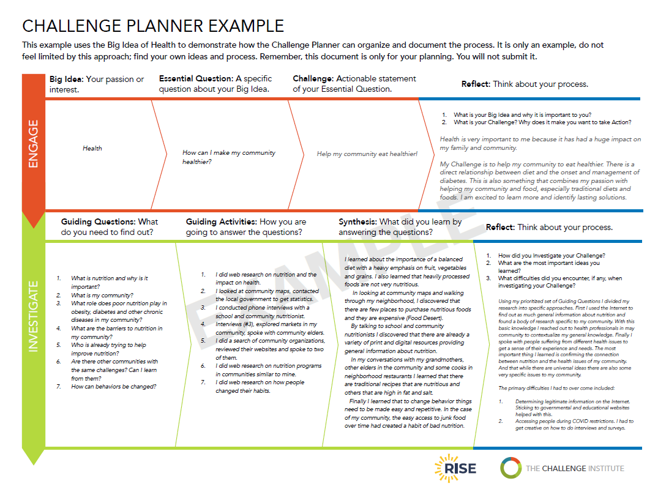

Slide 77
Task to do 2
Individual work:
⮚ Starting from the following “Big Idea: “Combat bullying in your community school” write the:
Essential Question and
Guiding Questions
⮚ Answer why such CBL lesson would be beneficial for your pupils (what would be the advantages compared with a more traditional approach to teaching such a topic)?
⮚ How long do you think this CBL lesson would last with your pupils (hours, days or weeks)?
⮚ Share the Essential Question and Guiding Questions and the envisaged duration of your CBL lesson, with other trainees.
⮚ By using the Challenge Planner provided by the trainer (Annex 2.1), fill it in as much as possible.
Working time: 40 minutes

Slide 78
References
1. CBL Guide 2016, https://www.challengebasedlearning.org/wp-content/uploads/2019/02/CBL_Guide2016.pdf
2. Apples for Kids / Challenge Based Learning, Gathering Evidence with Challenge Based Learninghttps://applesforkids.org/archives/category/challenge-based-learning/
3. Rise Challenge Planner, https://www.challengebasedlearning.org/wp-content/uploads/2021/02/Rise_challenge_planner.pdf
5. Challenge Based Learning Organisation, https://www.challengebasedlearning.org/project/cbl-rubric/
6. Challenge-Based Learning An Approach for Our Time, https://www.challengebasedlearning.org/wp-content/uploads/2019/05/CBL_approach_for_our_time.pdf

Slide 79
Thank you for attention!

Slide 80
"The European Commission's support for the production of this publication does not constitute an endorsement of the contents, which reflect the views only of the authors, and the Commission cannot be held responsible for any use which may be made of the information contained therein.”
Project Number:

