Slide 1
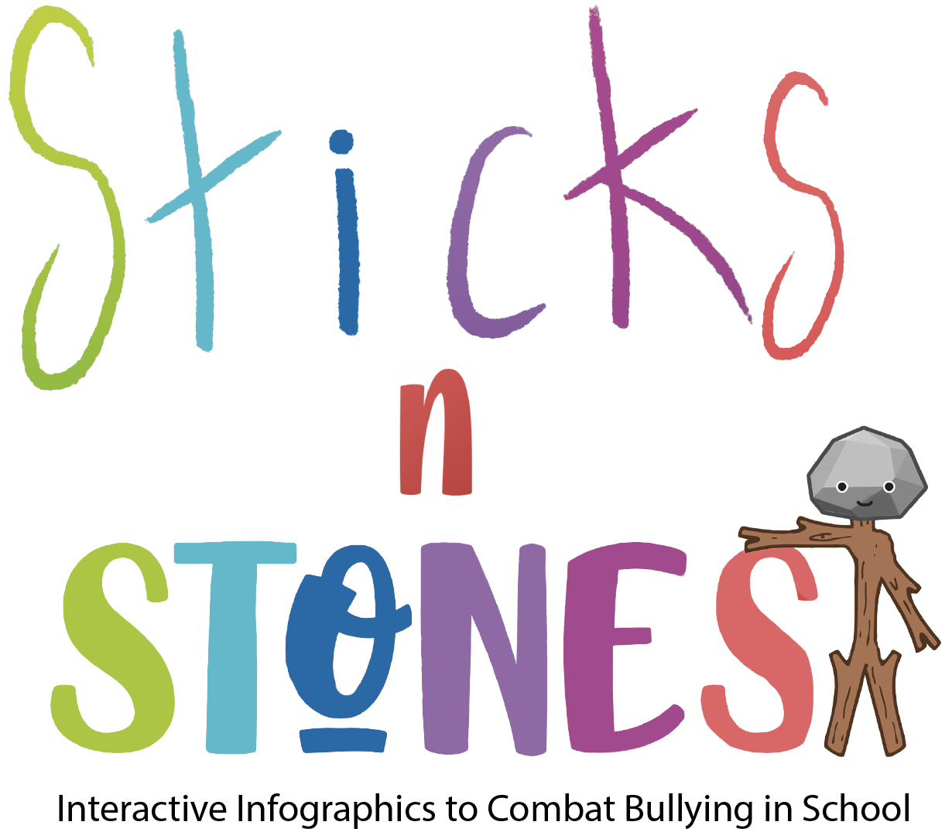
IO2: Module 2
F2f learning

Slide 2
Aim of Module 3

Slide 3
This module includes an introduction to interactive platforms, like PowToon, StoryBoardThat, Google Forms, Canva, KAHOOT, LearningApps etc. as well as an introduction on how these can be applied in a primary school setting.
This module also teaches primary school teachers some of the key functionalities, features and best practices to follow when using these resources; and it shows how they can develop interactive and engaging materials using these software programmes.
This module contains 3 main activities (or lessons): A3.1, A3.2, A3.3.

Slide 4
Structure of Module 1
Activity 3.1:
Interactive platforms for education: definition, features and examples
Activity 3.2:
Why and how to use interactive platforms in primary education: explanations, advices and tips
Activity 3.3:
Practical examples on how to create educational digital content with interactive platforms

Slide 5
Activity 3.1:
Interactive platforms for education: definition, features and examples

Slide 6
A.3.1 Interactive platforms for education: definition, features and examples
Definition
Learning platform, educational platform, interactive platform for education…Many names – a single concept:
“A learning platform is an integrated set of interactive online services that provide teachers, learners, parents and others involved in education with information, tools and resources to support and enhance educational delivery and management.” (eLiterate, https://eliterate.us/what-is-a-learning-platform/)
“A educational platform or academic platform it is a virtual program whose function is to create virtual spaces to share information. It is intended for teachers and students. It is widely used in universities and schools, both face-to-face and online.” (GMOL Solutions, https://gmolsolutions.com/en/blog/what-are-educational-platforms-for/ )
“An educational platform is a widely-used term, used to define an integrity of tools and services for writing, storing, disseminating digital communication, manage students activities, searching information etc.”
(IGI Global, https://www.igi-global.com/dictionary/emerging-platform-education/42260 )

Slide 7
A.3.1 Interactive platforms for education: definition, features and examples
Features (1)
Customized Learning: the interactive platforms offer personalized content that suits the requirements of various geographies, knowledge levels and competencies.
Train-as-you-go: digital platforms function on a train-as-you-go basis; the learners don’t have to halt their learning process just because they are not present within the educational unit premises.
Instructor-Led Virtual Learning: even while learner browses through a variety of animations, presentations, guidebooks and simulations, an instructor always remains present to interact, clarify, explain and therefore lends the session a dignified ‘human’ touch.

Slide 8
A.3.1 Interactive platforms for education: definition, features and examples
Features (2)
Activity Oriented Learning: the activities included in the interactive platforms (from online quizzes and app simulations to role playing, scenario-based learning, case studies, hands-on practice) make the learning process interesting, informative, useful and increase the learner engagement rate exponentially.
Interactive Tools: the multiple tools and techniques (e.g. eBooks, interactive PDFs, gamification, leader boards, downloadable lessons, editable documents and remote classroom collaborations) enhance interactivity and make way for performance-based outcomes
Comprehensive Outcome Reports: online platforms allow teacher to prepare expertly designed, well-crafted and informative outcome tracking reports on learner progress and assessment results, in a comprehensive manner.

Slide 9

Task to do 1
Work in pairs
➢ Create pairs;
➢ Ask your pair but also answer him/her the questions below:
How do you feel about interactive platforms for education: are they useful for pupils’ school performance? But for the teachers?
Have you used before such platforms? Which ones?
Working time: 5 minutes

Slide 10
A.3.1 Interactive platforms for education: definition, features and examples
What makes an eLearning Platform Interactive? (1)
Interactivity in eLearning can work wonders, far beyond your imagination. The higher is the scope of interactivity in online education, the more it motivates the learners towards critical thinking and holistic learning.
It has been observed that online learners engage better on an interactive eLearning platform, and build an environment suitable for active learning. eLearning interactivity induces alertness and long-term memory activation among the learners and helps them in improving their performances efficiently. Not only that, interactive online sessions encourage decision making and allow users to respond smartly.

Slide 11
A.3.1 Interactive platforms for education: definition, features and examples
What makes an eLearning Platform Interactive? (3)
The degree of interactivity contributes to the overall quality of an eLearning portal.
Being an interactive platform it is not only about the course content provided by that leaning platform.
The content is a very important feature, but an eLearning platform has to have a set of characteristics in addition to your unique content that can not only attract the interest of the users but also leads to active eLearning session ensuring their retention.
The 5 features in the next slides, that make an eLearning Platform interactive, have been tested and proven that ensure better traffic and engagement of the learners.

Slide 12
A.3.1 Interactive platforms for education: definition, features and examples
What makes an eLearning Platform Interactive? (4)
5 features:
1. Sharper User Interface
2. Collaborative Dashboard
3. Multi-Device Usage
4. Course Recommender
5. Gamification

Slide 13
A.3.1 Interactive platforms for education: definition, features and examples
What makes an eLearning Platform Interactive? (5)
1. Sharper User Interface (UI)
Presentation is the first thing users see when exploring an eLearning platform. Before making a decision whether to subscribe or not, they simply browse the entire app and determine the look & feel as well as the functionality of the eLearning module.
In such scenarios, everything including the portal’s layout, graphics, videos, icons, colour palate and navigation referring to the UI, effectively contributes to eLearning interactivity. When users navigate clearly through the eLearning app/website and find it easy to access the course content, the extraneous cognitive load on them is greatly reduced, and hence they make a decision in favour of the platform.
UI is never about making the screen look pretty, it’s always about guiding users through the learning experience.

Slide 14
A.3.1 Interactive platforms for education: definition, features and examples
What makes an eLearning Platform Interactive? (6)
2. Collaborative Dashboard
eLearning is not only about streaming video courses and reading the lines of text, but it’s also something much more advanced and interactive. The primary factor that makes online education highly engaging is collaborative learning.
Just like in the classroom, eLearning also allows learners to socially interact with other participants and instructors, but virtually. Through collaborative learning, learners can enrich their learning experiences by sharing chapter assessments, study materials, course links, and quizzes with others, via live chats, instant messaging and forum boards.
For an interactive learning environment, the eLearning portal must have a collaborative dashboard, where students/professionals can access all their course collateral.

Slide 15
A.3.1 Interactive platforms for education: definition, features and examples
What makes an eLearning Platform Interactive? (7)
3. Multi-Device Usage
Today’s learners use devices of all sizes and shapes – mobile phones, tablets, laptops, desktops, and smart TVs to access eLearning courses. Depending on their location & convenience, they prefer switching multiple devices from smartphones to computers and explore the courses they need.
Almost all millennials (nearly 87%), use two to three devices per day to receive training & learning from online education portals.
Hence, creating multi-device eLearning is a great way to enhance interactivity among users. Once users find it comfortable to access courses on their preferred devices, no matter where they are, there will be definitely a surge in the eLearning platform’s engagement stats.

Slide 16
A.3.1 Interactive platforms for education: definition, features and examples
What makes an eLearning Platform Interactive? (8)
4. Course Recommender
For learners, selecting the right course is always a confusing task. Especially, when the platform has a huge content library, users will definitely face difficulties in making a choice.
In such situations, if the platform automatically recommends relevant courses to the users, there are high chances, they will go with the suggested courses and will continue to engage with the provided eLearning service.
Basically, a course recommender is an artificial intelligence-based software program that helps e-Learners to choose an appropriate course as per their preference and capability.

Slide 17
A.3.1 Interactive platforms for education: definition, features and examples
What makes an eLearning Platform Interactive? (9)
5. Gamification
In the field of online education, Gamification is not a new concept. Many leading eLearning apps have been using this feature to promote commitment & active interest of students or professionals.
Extensive studies say games are very effective in increasing the level of motivation & interaction in learning, which in result greatly optimizes the learning process and shapes the knowledge of learners.
An interactive platform integrates favourite gamification techniques like progress level, scores, avatars, virtual currencies, gifts, real-time performance feedback, and more.
When users will get involved through gamification, then learning will be fun!

Slide 18

A.3.1 Interactive platforms for education: definition, features and examples
Advantages of eLearning platforms of being interactive

Slide 19
A.3.1 Interactive platforms for education: definition, features and examples
Examples of Interactive Platforms for education (1)
There are many Interactive Educational Platforms, either school/class/learning management systems or platforms for creating digital educational resources.
Examples of school/class/learning management systems:
Kinderpedia: https://www.kinderpedia.co/ Edmodo: https://new.edmodo.com/ EasyClass: https://www.easyclass.com/ Google Classroom: https://classroom.google.com Moodle: https://moodle.org/ | Blackboard: https://www.blackboard.com/ Coursera: https://www.coursera.org/ Microsoft Teams: https://www.microsoft.com/ EdApp: https://www.edapp.com/ Edx: EdX.org

Slide 20
A.3.1 Interactive platforms for education: definition, features and examples
Examples of Interactive Platforms for education (2)
Examples of online platforms for creating digital educational resources :
In this module, in A3.1 and A3.2, we will show you how to use the online platforms to create digital educational resources.
PowToon: https://www.powtoon.com/ StoryBoardThat: https://www.storyboardthat.com/ Google Forms: https://www.google.com/intl/en-GB/forms/about/ | Canva: https://www.canva.com/ Kahoot: https://kahoot.com/ LearningApps: https://learningapps.org/

Slide 21
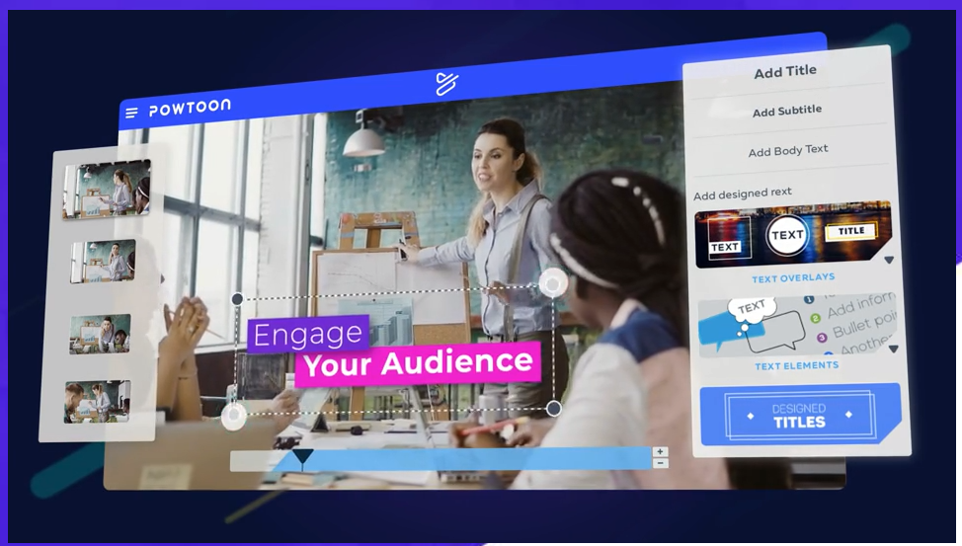
A.3.1 Interactive platforms for education: definition, features and examples
Examples of Interactive Platforms for education (3)
Powtoon: is a visual communication platform that gives you the freedom to create professional and fully customized videos your audience will love (engaging animated explainers, videos, video and cam recordings and more, for your classroom).

Slide 22
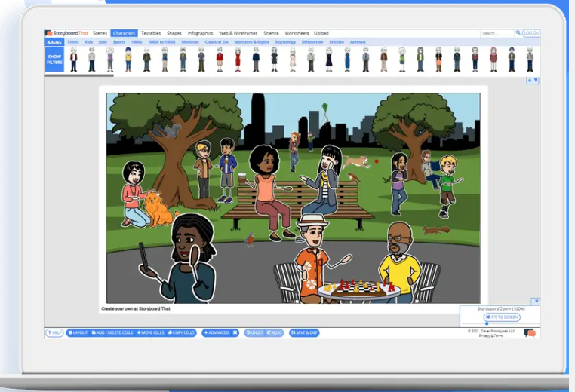
A.3.1 Interactive platforms for education: definition, features and examples
Examples of Interactive Platforms for education (4)
StoryBoardThat: is an online storyboard with a simple drag and drop interface and a large collection of custom artwork that makes it easy for students and teachers to create great looking storyboards that bring visual learning to life (graphic novels, comics, lesson plans, activities, posters, videos and more).

Slide 23
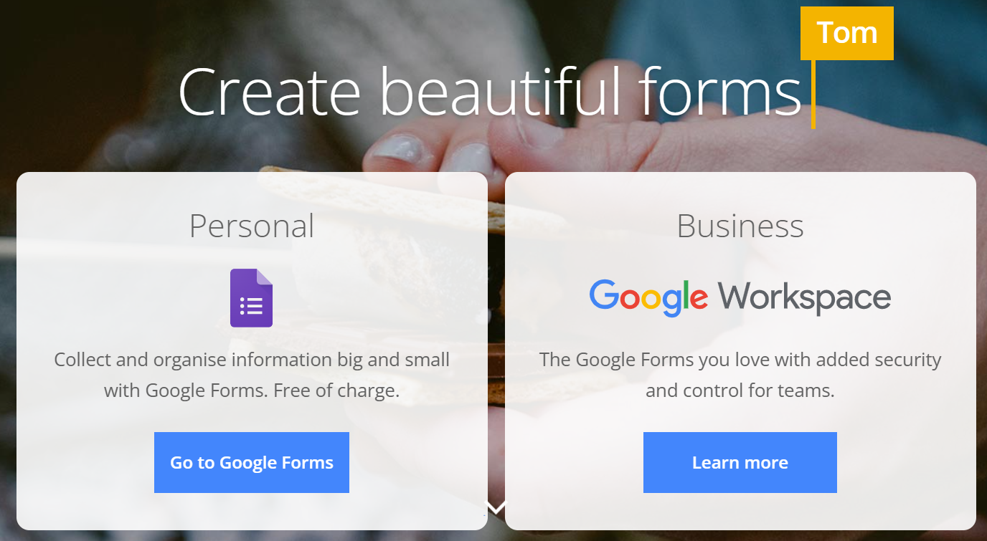
A.3.1 Interactive platforms for education: definition, features and examples
Examples of Interactive Platforms for education (5)
Google Forms: part of the Google suite (Google Docs, Google Sheets, Google Slides, etc.) is a platform that allows you to manage event registrations, create a quick opinion poll, create and analyse surveys, quizzes, questionnaires and more.

Slide 24
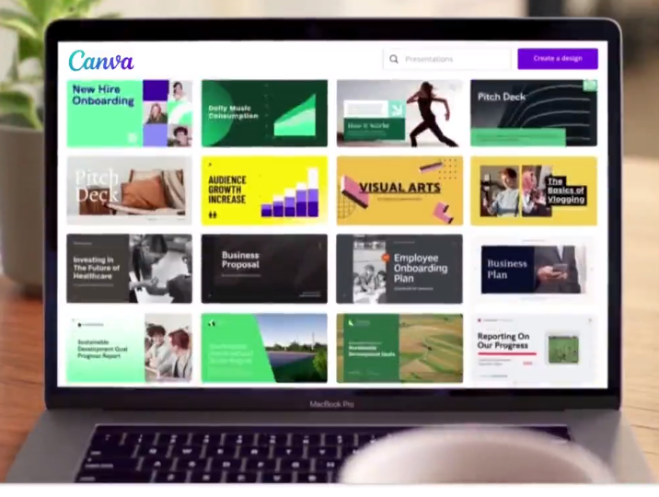
A.3.1 Interactive platforms for education: definition, features and examples
Examples of Interactive Platforms for education (6)
Canva: is a free-to-use online graphical tool that combines design, photo editing, and layout to help teachers and students create beautifully finished projects; a powerful online design tool that can transform a class, both in-room and remotely.

Slide 25
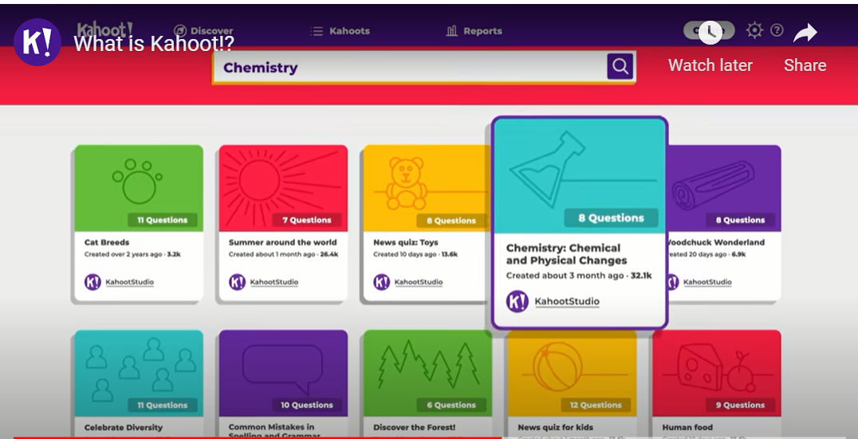
A.3.1 Interactive platforms for education: definition, features and examples
Examples of Interactive Platforms for education (7)
Kahoot: is a game-based learning platform that makes it easy to create, share and play learning games or trivia quizzes in minutes. It allows you to unleash the fun in classrooms, offices and living rooms!

Slide 26
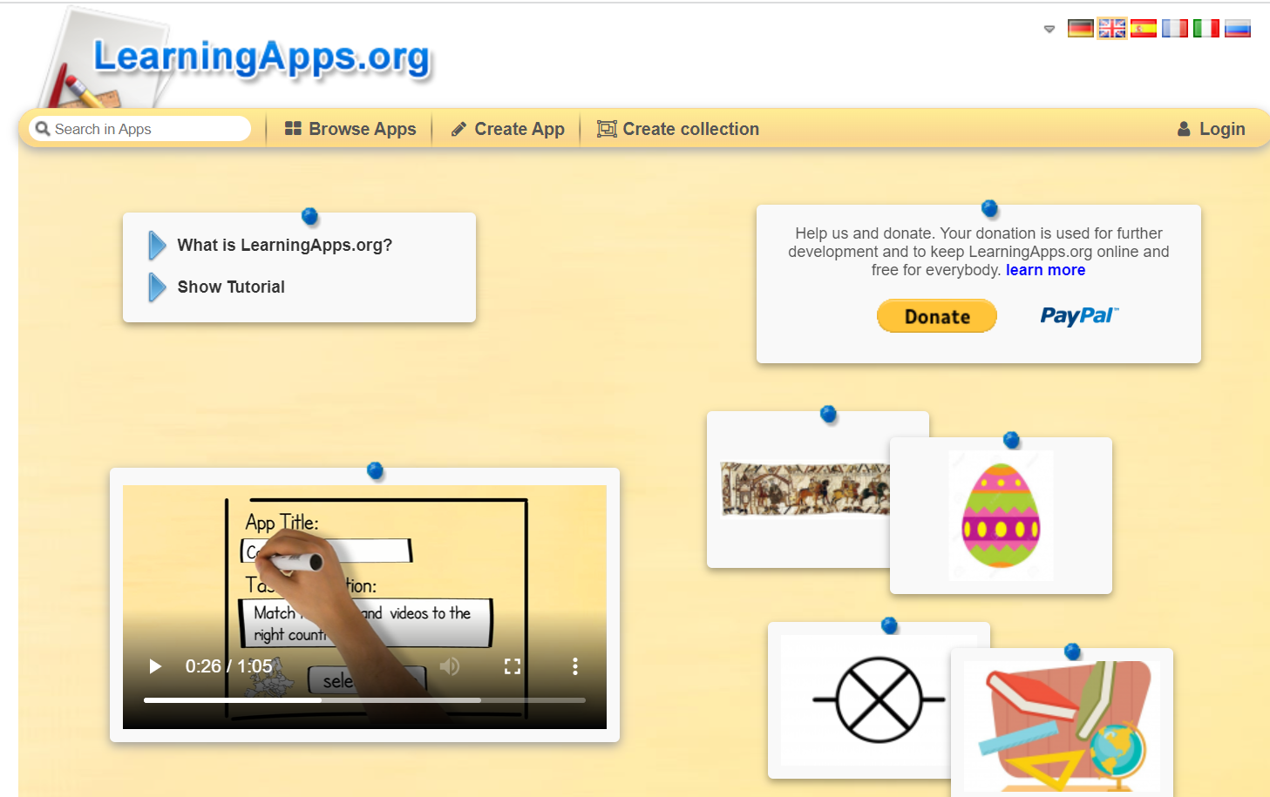
A.3.1 Interactive platforms for education: definition, features and examples
Examples of Interactive Platforms for education (8)
LearningApps: is a platform that supports learning and teaching processes with small interactive, multimedia exercises. The exercises can be created and used very easily online. A number of templates (assignment exercises, multiple choice tests, etc.) are available.

Slide 27
Task to do 2
Individual work
➢ Based on the information received from the trainer so far, reflect few minutes on the following questions.
➢ Formulate brief answers, write them down and be ready to share them with the other trainees when/if the trainer will nominate you!
Which are your reasons, as a primary teacher, to use interactive platforms in your classes/lessons?
How do you, as a primary teacher, intend to change your teaching approach by including digital learning through interactive platform?
Working time: 10 minutes

Slide 28
A.3.1 Interactive platforms for education: definition, features and examples
Benefits of using Interactive Platforms for education (1)
1. Personalised Learning
2. Breadth of Information
3. More Engaging Lessons
4. Develops Accountability
5. Learning Flexibility
Notes:
1. With digital learning, the teacher is able to format their curriculum based on the needs of the individual. It also makes it easier for them to provide confidential individual feedback to each student.
2. Digital learning taps easy access to information and helps students to use it effectively. It provides relevant material across a limitless range of topics to help facilitate the best possible outcome in the learning journey.
3. Digital learning offers a larger range of delivery methods for learning. Imagery, audio and video content can all be integrated seamlessly into a lesson. All these helps to make learning more fun, which in turn will raise the retention of the content taught in the lessons.
4. Young students on this kind of educational path will experience problem-solving, concept maps, storytelling, gamification, role-playing, peer education, and a much higher frequency than those learning under the traditional format. They will often seek to expand their own knowledge base simply because they enjoy the satisfaction that comes with knowing more.
5. There’s a greater deal of flexibility in the delivery of digital lessons. Also, with digital learning, there’s more flexibility to enable students who experience Autism and ADHD to still get the most out of their education.

Slide 29
A.3.1 Interactive platforms for education: definition, features and examples
Benefits of using Interactive Platforms for education (2)
6. Recorded Content
7. 24-Hour Resources
8. Connected Learning
9. Easy to Track Student Progress
10. Improves Written Language Skills
Notes:
6. This is a benefit for students of all ages, especially kids. Children in early development greatly benefit from repetition. This allows them to have that in between lessons, which will help them progress much faster. It also allow learners to do additional study in their own time to catch up.
7. Leaners can catch up in their own time because all of the resources they need are available to them 24 hours a day.
8. When they are taking part in online learning, learners instantly become part of a community of like-minded individuals sharing the same experience as they are.
9. There’s an online record of all work that’s completed as well as attendance and the results of exams. An online teacher can identify an area a student needs help with long before the student or their parents.
10. Online learning normally involves large amounts of written communication. Students who come up through a digital learning environment will stand a better chance of being able to touch type, which is an essential skill for the job markets of the future.

Slide 30
A.3.1 Interactive platforms for education: definition, features and examples
Benefits of using Interactive Platforms for education (3)
11. Accessibility Through Modern Technology
12. Involves Educators and Parents
13. Rapidly Increases the Sharing of Information
14. Increases Students Employability
15. It’s Fun and Engaging!
Notes:
11. We used to rely on exchange students to be able to experience other cultures and languages, but now, all of that is accessible to everyone, regardless of their income or ability to travel.
12. This kind of approach also allows students to feel a certain degree of autonomy while allowing their parents and teachers to communicate confidentially in order to provide the best possible learning outcome for the student (i.e. the twice-yearly parent-teacher interview can easily become a weekly check-in).
13. It allows students to access more information, but it also enables them to cater it specifically to their individual needs. It also saves time and money. Students no longer have to buy or rent large volumes of textbooks just to use about 30% of them before the information is no longer relevant. The digital learning landscape has also made it possible for educators to adapt to different situations and share information rapidly.
14. We need to make sure the students of today are prepared for the job market that awaits them tomorrow. The best way to provide this is to give them access to a digital learning platform. It will help them become familiar with new technologies and tune skills that will be necessary in the future.
15. This is the no-brainer of all of the arguments for the benefits of digital learning. Students who experience fun or joy within their educational environment retain information and succeed at a much higher rate than those who don’t.

Slide 31
Task to do 3
Group work
➢ Create two groups (the trainer will support the creation of the groups);
➢ Starting from the questions “How does interactive platforms can support modern teaching-learning process?” create a mind map, share and explain it with the whole class (the other trainees).
Working time: 25 minute

Slide 32
References
1. eLiterate, What is a Learning Platform?, https://eliterate.us/what-is-a-learning-platform/
2. GMOL Solutions, What are educational platforms for?, https://gmolsolutions.com/en/blog/what-are-educational-platforms-for/ )
3. 6 Must-have Features for Interactive Online Platforms, https://kitaboo.com/must-have-features-interactive-online-platforms/
4. Muvi Blogs, Top 5 Features that make an eLearning Platform Interactive, https://www.muvi.com/blogs/5-features-of-interactive-e-learning-platform.html
5. Powtoon, https://www.powtoon.com/
6. StoryBoardThat: https://www.storyboardthat.com/
7. Google Forms: https://www.google.com/intl/en-GB/forms/about/
8. Canva: https://www.canva.com/
9. KAHOOT: https://kahoot.com/
10. LearningApps: https://learningapps.org/
11. The Top 15 Benefits of Digital Learning, https://mussila.com/the-top-15-benefits-of-digital-learning/

Slide 33
Activity 3.2:
Why and how to use interactive platforms in primary education: explanations, advices and tips

Slide 34
A.3.2 Why and how to use interactive platforms in primary education: explanations, advices and tips
The need to use Interactive Platforms in education in pandemic times and after (1)
The impact of Covid-19 pandemic disrupted education globally. There is no excuse for being unprepared again.
Lessons learned or what we know now:
1. Schools and teachers can no longer rely on a print-only teaching strategy. Programs will have to adopt a blended approach, with some built-in digital redundancy.
2. Schools are expected to have a far more sophisticated approach on remote learning/teaching the next time around.
3. Online learning must ultimately minimize loss of teaching and learning efficiency and effectiveness.

Slide 35
A.3.2 Why and how to use interactive platforms in primary education: explanations, advices and tips
The need to use Interactive Platforms in education in pandemic times and after (2)
4. Much more will be expected of ed-tech tools and platforms.
5. Teachers across countries have taken a crash course in tech during pandemics. They are likely to emerge with new-found knowledge of what works and what they like. They will have a compelling point of view on what an excellent tech tool or platform needs to offer.
6. Physical isolation will increase the need for more social connections on these tools. There is a reason Zoom’s gallery view has emerged as such a powerful and must-have feature.
7. Not every class can be effectively taught online or remotely. Lab-based learning, or music, for instance, is that much harder to do remotely.

Slide 36
Task to do 4
Discussion (whole class):
➢ How did you manage to implement your online teaching during the Covid-19 pandemic, what digital supports have you used?
➢ What would you do differently and why?
Working time: 15 minutes

Slide 37
A.3.2 Why and how to use interactive platforms in primary education: explanations, advices and tips
The need to use Interactive Platforms in education in pandemic times and after (3)
Planning for the future:
1. Education service providers work to support the learning institutions. Some of them are providing free online courses, while some are offering courses at heavily discounted rates.
2. And then we have online learning platforms that are equipped with all the features required for students to fulfil their learning needs. Complete with collaboration tools, online assessments, data analytics, offline reading facility and interactive learning content, these platforms are what students require today.
3. Educators can also opt for a blended learning model empowered by technology. These technology-enabled solutions can improve the overall learning experience of students and the efficacy of the education system.

Slide 38
A.3.2 Why and how to use interactive platforms in primary education: explanations, advices and tips
The need to use Interactive Platforms in education in pandemic times and after (4)
4. The remote learning trend is expected to continue even after the pandemic subsides. It will probably take months for schools and universities to get back to what was once considered normal - with students and teachers coming to the classrooms and participating in knowledge sharing sessions. Therefore, it is best to adopt the solution that we have right now in front of us and adapt it for the future while we explore other viable alternatives. We don’t know what the future holds, but we can at the very least be prepared for it!

Slide 39

Before moving on, let’s reflect about how we can support primary school children online and watch the advice from Dr. Linda Papadopoulos, Ambassador of Internet Maters organisation, on this topic!
https://www.internetmatters.org/resources/discovering-digital-at-primary-school/

Slide 40
Task to do 5
Individual work + discussion: Slip writing
➢ Use the worksheet in Annex 3.1 to write down the main questions you might have about using interactive platforms in primary education.
➢ When finished, pass your worksheet to the trainer. S/he will use it for anonymous question asking, with the whole class.
➢ Debate will be generated and coordinated by the trainer.
Working time: 25 minutes

Slide 41
A.3.2 Why and how to use interactive platforms in primary education: explanations, advices and tips
Advice and tips on how to use interactive platforms in primary education (1)
Edtech (education technology) refers to software, hardware and processes intended to support teaching and the day-to-day management of education institutions.
Advice and tips that primary schools should consider when choosing and implementing edtech solutions.
Focus on your needs: finding the right tech for your school should begin with identifying your needs, then looking for a solution – not the reverse. Pick the right tech to fit your school’s individual culture.
Use tech that enhances, not diminishes, teacher-pupil contact: the best technology augments, not replaces, teacher-pupil interactions. By providing teachers with detailed data on each child’s performance, their strengths, weaknesses and behaviours, technology can allow teachers to interact in a far more meaningful and helpful way with pupils.
Notes:
More on this topic, at: https://digitalagenda.io/insight/7-tips-on-choosing-edtech-from-a-primary-teacher/

Slide 42
A.3.2 Why and how to use interactive platforms in primary education: explanations, advices and tips
Advice and tips on how to use interactive platforms in primary education (2)
Involve children in how the tech is used: as opposed to giving a teacher more work and commitment, consider tech solutions that allow the children themselves to get involved with its running.
Use what works, not what is trendy: it is important that tech is chosen for its proven benefits, not its shiny interface, and that when tech is implemented, it is continuously monitored for its impact. Good learning platforms should always keep you informed of if they’re actually working.
Choose ‘one-size-fits-one’, rather than ‘one-size-fits-all’: tech is at its most accessible when it offers learners options; tech should be specialised for each child as individuals.
Notes:
More on this topic, at: https://digitalagenda.io/insight/7-tips-on-choosing-edtech-from-a-primary-teacher/

Slide 43
A.3.2 Why and how to use interactive platforms in primary education: explanations, advices and tips
Advice and tips on how to use interactive platforms in primary education (3)
Make online and offline learning compatible: when tech is implemented at its best, it complements the existing teaching and learning taking place in the classroom. The best technology is able to be combined and compatible with the learning going on offline, too. All platforms should work alongside classroom learning and not restrict it.
Embed it everywhere, not just in the classroom: some children may not have the same opportunities to access technology at home. When technology is implemented it should never widen the gap. Make sure there are ways for learners to benefit from the technology at lunchtime clubs or before and after school.
Log in on a daily basis: this is a strategy that will be beneficial to all-year groups. Logging in seems like a relatively simple task but one which can take a long time if students are not used to doing it on a daily basis (forgetting passwords, etc.)
Notes:
More on these topics, at:
https://digitalagenda.io/insight/7-tips-on-choosing-edtech-from-a-primary-teacher/
https://www.canopy.education/post/edtech-top-tips-for-teachers

Slide 44
A.3.2 Why and how to use interactive platforms in primary education: explanations, advices and tips
Main steps to use interactive platform
to create educational digital content
Contextualize learners by creating an intellectual need for information and skills
Design learning content on a trajectory of informal to formal
Maintain a constant view of the Big Picture
Design learning content to foster collaboration and conversation
Take advantage of and test apperceptive mass
Make it easy to interact and play
Notes:
Contextualize learners by creating an intellectual need for information and skills: begin your learning sequences with context – ask how you can help learners experience what they need. Facilitate reflection that creates a personal context for the information. It’s easier to get learners more invested in the “what” by focusing on the “why.”
Design learning content on a trajectory of informal to formal: start with an informal, no-right-answer inquiry, and from there move gradually toward formal definitions and explanations. Begin with hypothetical scenarios. Ask for situational conjuncture. Present a small fragment of your information and have learners discuss its implications without knowing the full context. Invite them to discover and explore before formalizing the experience.
Maintain a constant view of the Big Picture: keep learners contextualized throughout their entire learning experience. When presenting an activity or chunk of information, remember to insert Big-Picture reminders or reference points.
Design learning content to foster collaboration and conversation: look for opportunities in your content design to ask reflection questions that will stimulate personal inquiry and conversation.
Take advantage of and test apperceptive mass: design your content to take advantage of apperceptive mass and create deeply engaging and impactful learning experiences. Help learners test the limits of their previous experiences when it comes to drawing conclusions or making intuitive leaps.
Make it easy to interact and play: make the experience playful through interactivity and experimentation. Allow learners room for exploration. Let them play with the ideas first, without consequences from or concerns about being wrong, before moving into more formal instruction.

Slide 45
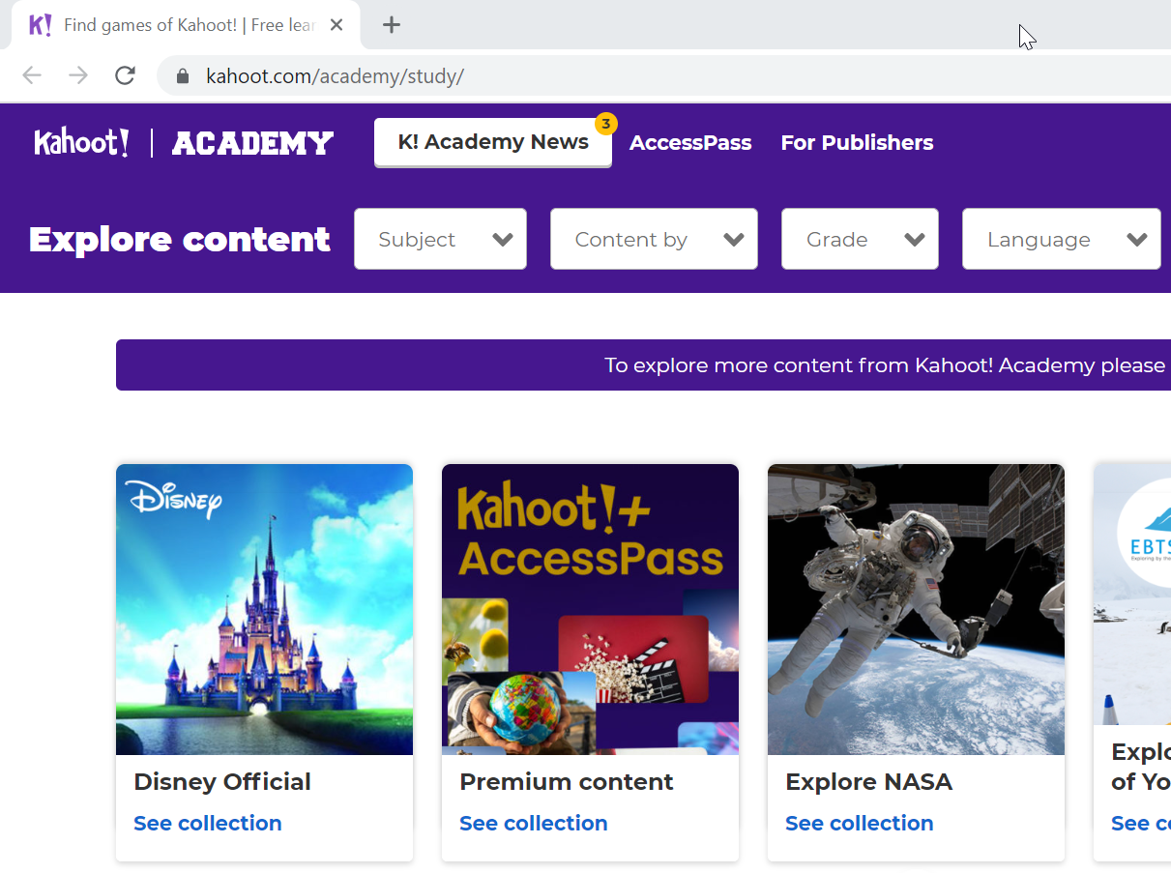
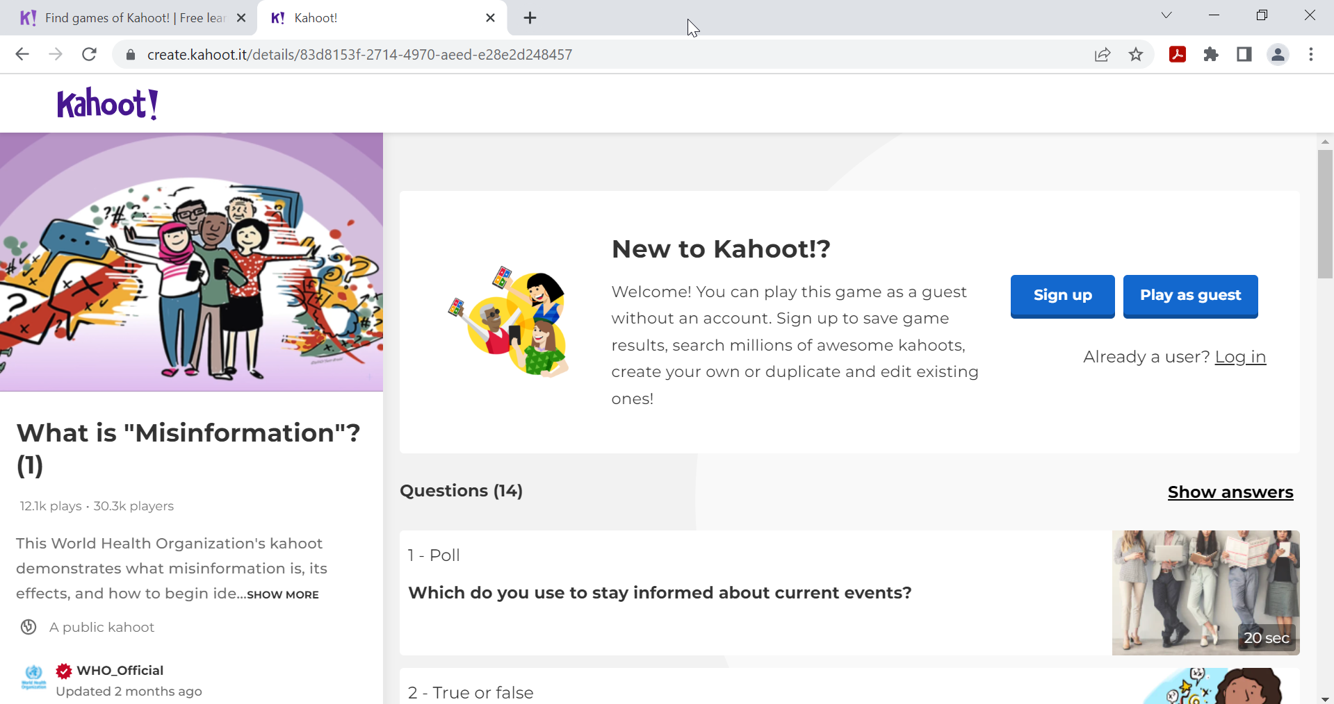
A.3.2 Why and how to use interactive platforms in primary education: explanations, advices and tips
Apply pre-designed digital resources offered by interactive platforms for education in own teaching (1)
Kahoot
1. You may find games of Kahoot at: https://kahoot.com/academy/study/
2. You may choose subject, content, grade and language from top buttons
3. You may apply the selected game(s) within your class
Notes:
The trainer will exemplify/demonstrate how to find pre-designed (existing) games of Kahoot by following the 2 steps described in this slide.

Slide 46
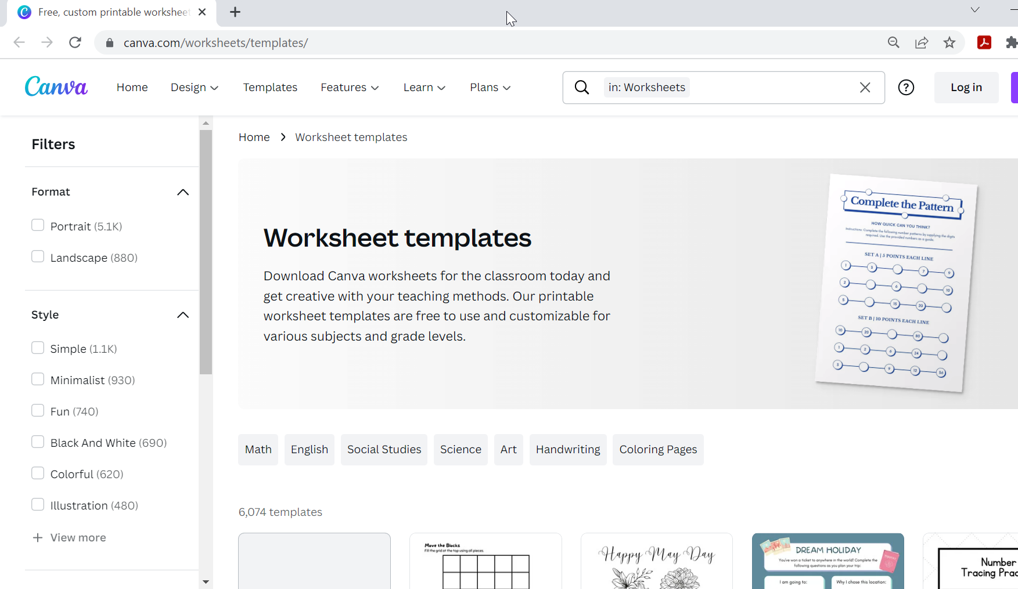
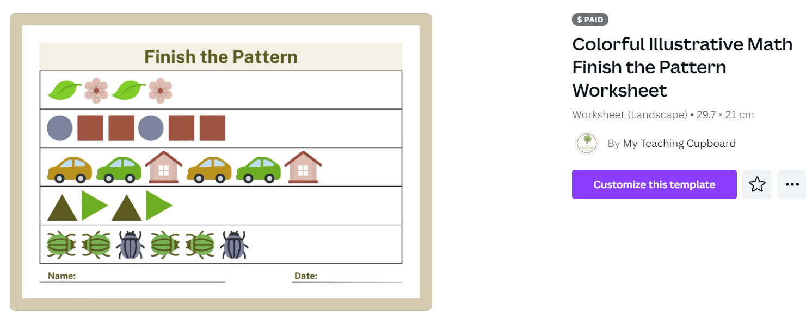
A.3.2 Why and how to use interactive platforms in primary education: explanations, advices and tips
Apply pre-designed digital resources offered by interactive platforms for education in own teaching (2)
Canvas
1. You may find worksheet templates of Canva at: https://www.canva.com/worksheets/templates/
2. You may apply filters and choose format, styles, theme, price (free/pro) from buttons on the left side
3. You may print and use the selected template(s) within your class
Notes:
The trainer will exemplify/demonstrate how to find pre-designed (existing) worksheet templates of Canva by following the 2 steps described in this slide.

Slide 47
Task to do 6
Work in pair: Neighbor discussion
➢ Speak to the person beside you/across from you to discuss which of the presented platforms, resource-types and templates you liked the most and why.
➢ In your discussion, answer the question:
What are 3 resources that you learned about in this course ad that you intend to use in the very next lessons that you will teach to your pupils after completion of this course?
Working time: 10 minutes

Slide 48
References
1. K-12 Education in the Post-COVID Era, https://kitaboo.com/k-12-education-post-covid-era/
2. Digital Agenda, https://digitalagenda.io/insight/7-tips-on-choosing-edtech-from-a-primary-teacher/
3. Canopy, https://www.canopy.education/post/edtech-top-tips-for-teachers
4. Net Thought, Six Tips for Creating Great Digital Learning Content, https://www.nextthought.com/thoughts/2016/09/six-tips-for-creating-great-digital-learning-content
5. Kahoot Academy, https://kahoot.com/academy/study/
6. Canva, Worksheet templates, https://www.canva.com/worksheets/templates/
7. Internet Matters, Discovering digital at Primary, https://www.internetmatters.org/resources/discovering-digital-at-primary-school/

Slide 49
Activity 3.3:
Practical examples on how to create educational digital content with interactive platforms

Slide 50
A.3.3 Practical examples on how to create educational digital content with interactive platforms
Create your own educational digital content with interactive platforms (1)
Google Forms
Watch the video tutorial at: https://www.youtube.com/watch?v=fXQDFhKFuTU
Read the tutorial at: https://support.google.com/docs/answer/6281888?hl=en&co=GENIE.Platform%3DDesktop

Slide 51
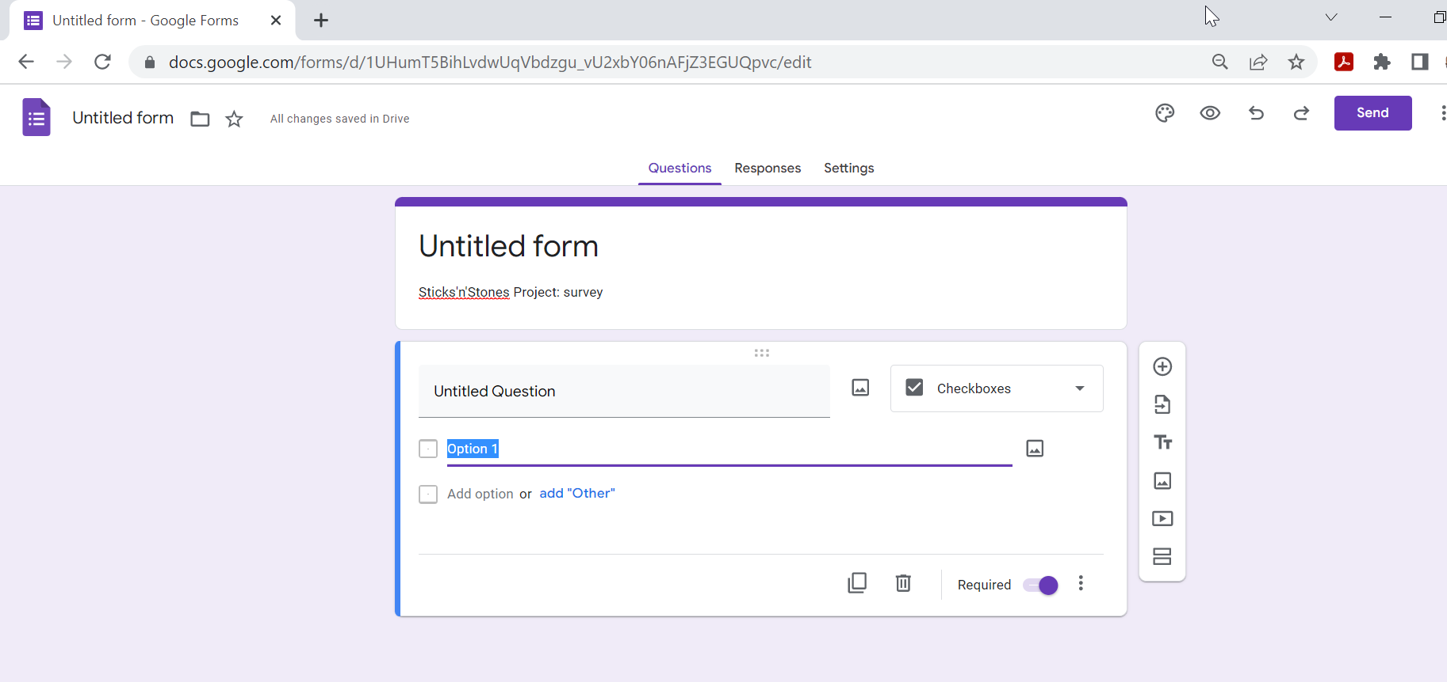
Task to do 7
Individual work
Access Google Forms at: https://docs.google.com/forms
Create a Google account / Sign in
Create a brief survey on cyberbullying in in your school (4-questions of different types)
Working time: 20 minutes

Slide 52
A.3.3 Practical examples on how to create educational digital content with interactive platforms
Create your own educational digital content with interactive platforms (2)
Powtoon Studio allows you creating video fast (without any video making skills or background), namely:
How to edit text
Swap props and characters
Use live-action video
Adjust the timeline and animation effects
How to edit your own characters with our new character builder
How to publish your amazing video.
Watch the video tutorial at: https://www.youtube.com/watch?v=vkfacjOpTcM
Read the tutorial at: https://www.powtoon.com/blog/how-to-create-an-animated-presentation-in-5-easy-steps/

Slide 53
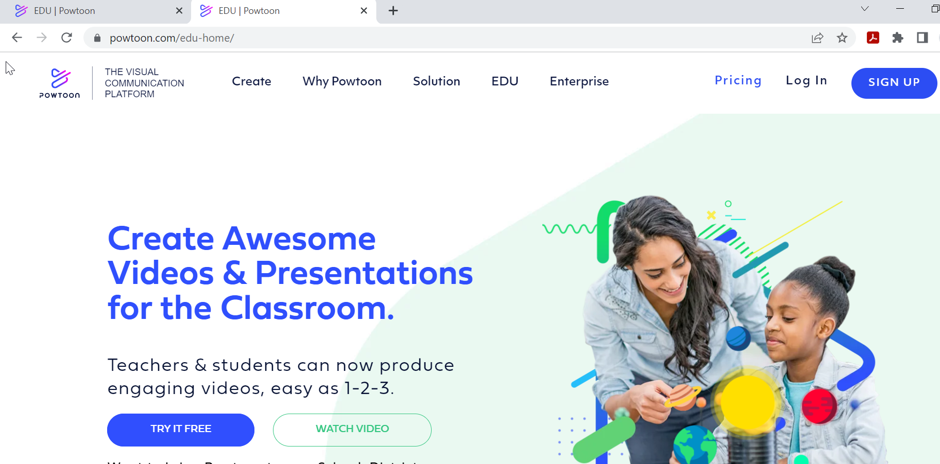
Task to do 8
Individual work
Access Powtoon at: https://www.powtoon.com/edu-home/
Click the button ‘Sign up’ or ‘Try it free’
Create a short video to raise awareness of your primary children on school bullying
Working time: 30 minutes

Slide 54
A.3.3 Practical examples on how to create educational digital content with interactive platforms
Create your own educational digital content with interactive platforms (3)
Canva
Watch the video tutorial at: https://www.canva.com/designschool/tutorials/canva-for-teachers/
Note that at:
https://www.canva.com/designschool/tutorials/canva-for-teachers/
you may find more tutorials for teachers on how to use Canva templates and resources.

Slide 55
Task to do 9
Individual work
Access Canva at: https://www.canva.com/
Create a Canva account / Sign in
Create class schedule for your pupils by choosing from provided templates
Working time: 15 minutes

Slide 56
A.3.3 Practical examples on how to create educational digital content with interactive platforms
Create your own educational digital content with interactive platforms (4)
Kahoot
Watch the video tutorial at: https://www.youtube.com/watch?v=KJgZZQcsSPk
Read the tutorial at: https://kahoot.com/blog/2021/01/28/how-to-create-kahoot-tips-teachers/

Slide 57
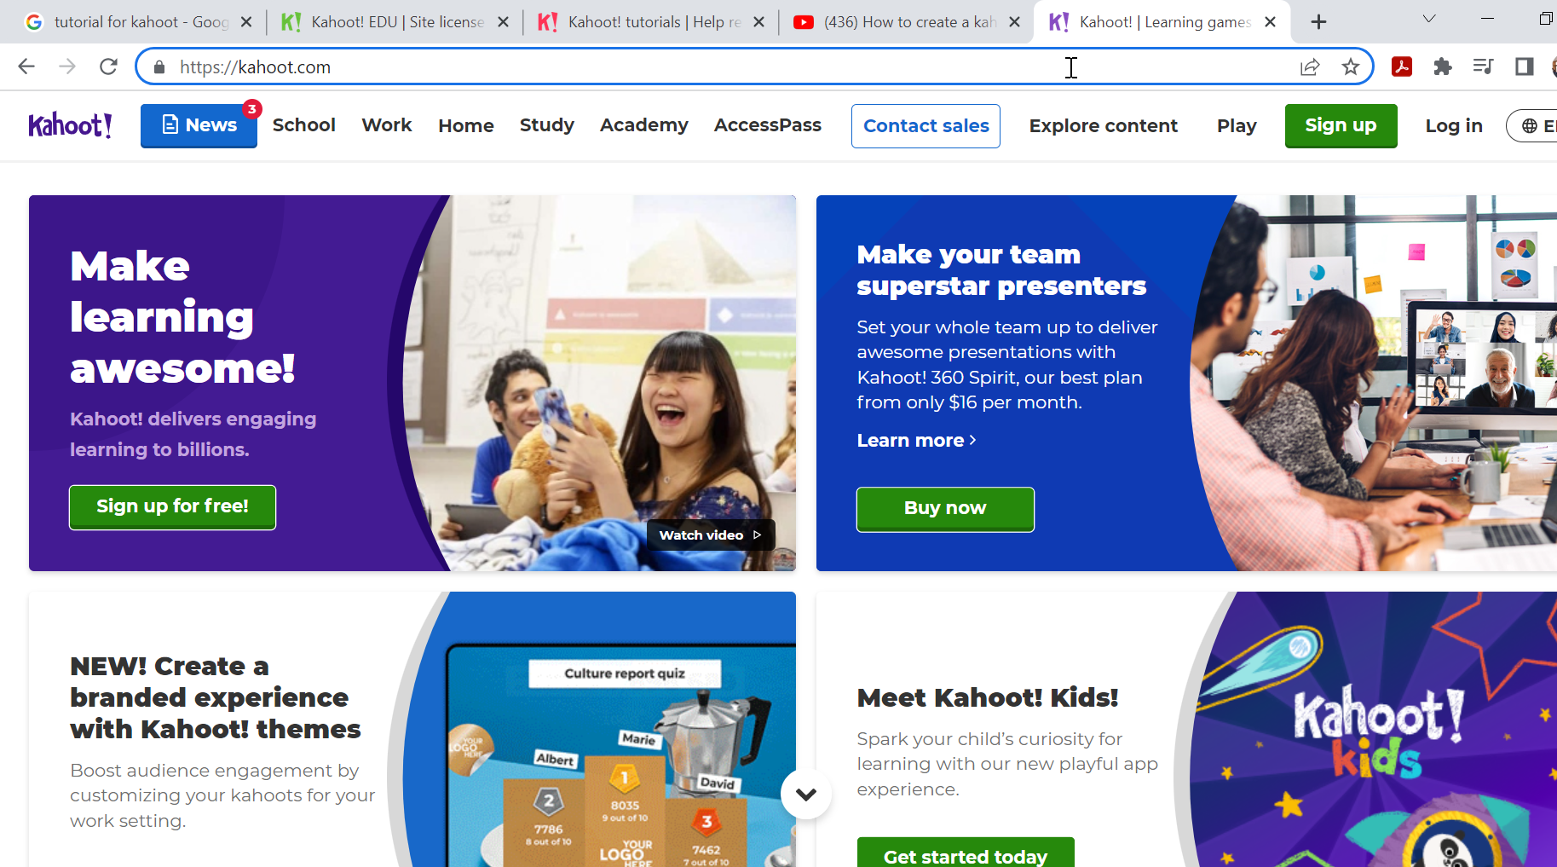
Task to do 10
Individual work
Access Kahoot at: https://kahoot.com/
Create a Kahoot account / Sign in
Create a brief assessment test (a game/quiz) on definition of school bullying and positive behaviour among primary pupils (3 multiple-choice items with 4 answer-options each, with 60 seconds solving time each item, and background image)
Working time: 20 minutes

Slide 58
References
1. How to use Google Forms to create a survey, https://www.youtube.com/watch?v=fXQDFhKFuTU
2. How to use Google Forms, https://support.google.com/docs/answer/6281888?hl=en&co=GENIE.Platform%3DDesktop
3. Google Forms, https://docs.google.com/forms
4. How to make video online in the Powtoon Studio / Powtoon tutorials, https://www.youtube.com/watch?v=vkfacjOpTcM
5. How To Create Cool Animated Presentations In 5 Easy Steps, https://www.powtoon.com/blog/how-to-create-an-animated-presentation-in-5-easy-steps/
6. Powtoon, https://www.powtoon.com/edu-home/
7. Canva for Teachers, https://www.canva.com/designschool/tutorials/canva-for-teachers/
8. Canva, https://www.canva.com/
9. How to create a Kahoot - tutorial, https://www.youtube.com/watch?v=KJgZZQcsSPk
10. How to create a Kahoot: Step-by-step guide and extra tips for teachers, https://kahoot.com/blog/2021/01/28/how-to-create-kahoot-tips-teachers/
11. Kahoot, https://kahoot.com/

Slide 59
Thank you for attention!

Slide 60








"The European Commission's support for the production of this publication does not constitute an endorsement of the contents, which reflect the views only of the authors, and the Commission cannot be held responsible for any use which may be made of the information contained therein.”
Project Number:

