Slide 1
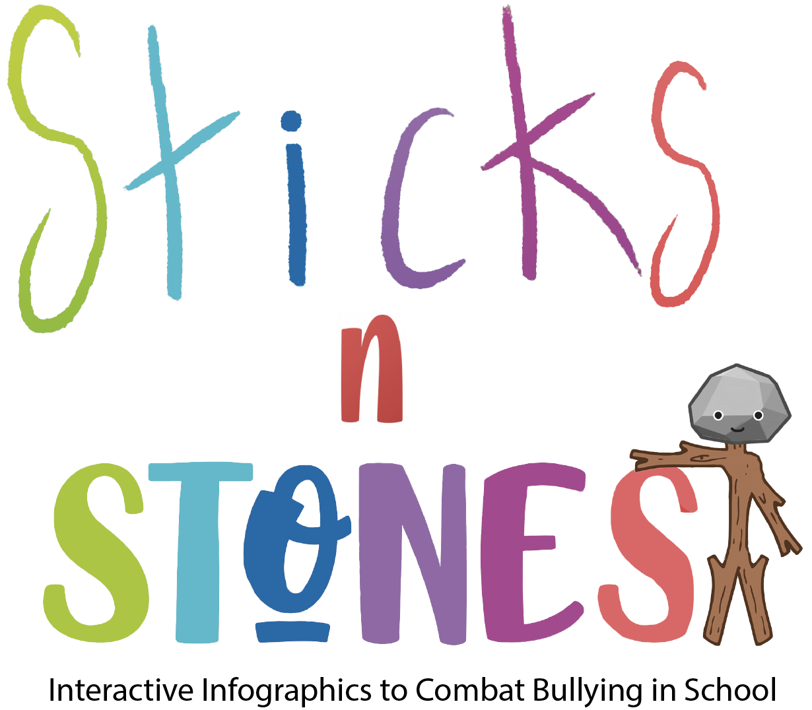
IO2: Module 1 F2f learning

Slide 2
Aim of Module 1

Slide 3
This module aims to build up primary teachers’ skills on how “Toolkit of Interactive Infographics Resources to Combat Bullying” can be applied to primary school classrooms.
The module includes sample lesson plans and will introduces the Lesson Plan Canvas to primary teachers, so that they can complete this planning template to help them to integrate these resources into their teaching practice.
This module also provides an introduction to some online safety and security tips for primary teachers to be aware of as they introduce digital resources into their teaching practice.
This module contains 3 main activities (or lessons): A1.1, A1.2, A1.3.

Slide 4
Structure of Module 1
Activity 1.1:
Using interactive infographics in primary education
Activity 1.2:
Safe online learning environments in primary education
Activity 1.3:
Creating digital lesson plans to use interactive infographics in primary education

Slide 5
Activity 1.1:
Using interactive infographics in primary education

Slide 6
A.1.1 Using interactive infographics in primary education
What is an Infographic?
An Infographic is:
“a picture or diagram or a group of pictures or diagrams showing or explaining information.” (Cambridge Dictionary)
“a visual representation of information or data, e.g. as a chart or diagram.” (Oxford Dictionary)
But the meaning of an infographic is something much more specific.
An infographic is a collection of imagery, data visualizations like pie charts and bar graphs, and minimal text that gives an easy-to-understand overview of a topic.
Infographics use striking, engaging visuals to communicate information quickly and clearly.

Slide 7
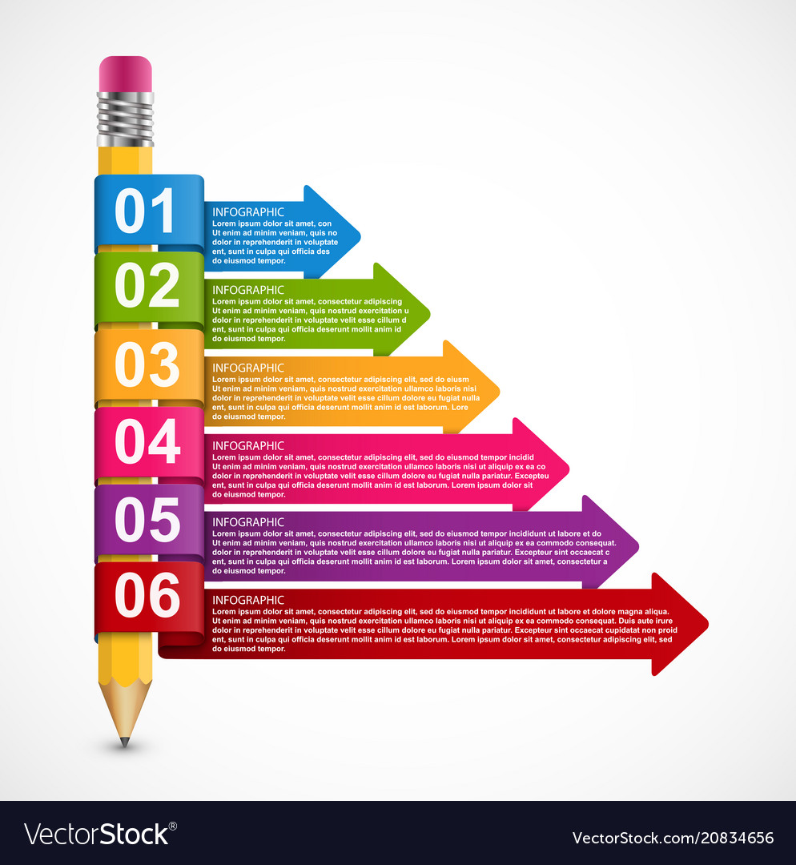
A good Infographic is worth a thousand words!

Slide 8
A.1.1 Using interactive infographics in primary education
Why to use an Infographic?
Because:
An infographic presents information and statistics using visual content to make it easier to understand a topic.
Infographics help you to keep your pupils interested (because images are more appealing than text) and allow them to comprehend any kind of information faster.
Therefore, you can explain complex topics, knowing that you’ll increase the chances of your pupils consuming the content and learning from it, compared with plain text.
Infographics summarize a large amount of data in a visually compelling way. Thus, you make your content easy to understand and digest.

Slide 9
Source:
Research Gate (2019), “Visualizing the terror threat. The impact of communicating security information to the general public using infographics and motion graphics”

Slide 10
A.1.1 Using interactive infographics in primary education
Types of Infographic
Static Infographic: it presents a static image with a large amount of text.
Animated Infographic: is similar to the static one, however, the difference is that some visual elements can move.
Motion Graphic: it is presented in the video format, often hosted on platforms such as Vimeo and YouTube, but it contains animated images and graphs instead of live-action.
Statistical Infographic: explore visual content to present data based on researches, analytic reports, and so on.
Interactive Infographic: allow the audience to click or drag specific elements of the image.
Notes:
Static Infographic requires organization and planning to decide what information will be added to it, to prevent the reader from getting confused while reading it.
Animated Infographic: the process to create this type of content is more complex and requires more resources and technical knowledge.
Motion graphic: as in the animated infographic, the production of this one requires technical knowledge. Most of them are 30 to 60 seconds long.
Interactive Infographic: Its creation also requires a high technical level due to its complexity.
It is by far the most interesting type of infographic because it makes it possible to use several features at the same material and gives the audience full control of how the content will be consumed.

Slide 11
A.1.1 Using interactive infographics in primary education
What is an Interactive Infographic?
An Interactive Information Graphic (or Interactive Infographic) is a visual representation of information that integrates different modes – e.g. image (which is the constitutive element), written text, sound, layout – into a coherent whole and offers at least one navigation option to control the graphic; its communicative function is to inform, e.g. by describing or explaining something or narrating a factual story.
Thus, an Interactive Infographic is a data-rich, visually compelling and engaging infographic that also utilizes animation so users can “interact” with the design.

Slide 12
A.1.1 Using interactive infographics in primary education
What is an Interactive Infographic for (primary) education and why is valuable for education
An Interactive Infographic is an engaging educational experience for pupils.
It consists of learning materials that engage pupils so that they “interact” with information.
In Sticks’n’Stones Project, the Infographic is presented as a poster with QR codes.
Usually, in an Interactive Infographic if you scan each QR code you will find it is linked to one of the following digital learning resources: quizzes, widgets, maps, games, graphs & charts, microsites, interactive video, ebooks, reports, calculators, polls & surveys, timelines.
In this way, a simple poster can be brought to life and turned into an educational resource!

Slide 13
A.1.1 Using interactive infographics in primary education
Features of Interactive Infographics
Data visualization (or information visualization)
Semiotic system
Interactivity
Linearity / non-linearity
Multimodality
Communicative function
Notes:
Data visualization: “the science of visual representation of -‚data’, defined as information which has been abstracted in some schematic form, including attributes or variables for the units of information”.
Semiotic system: As the second part of the compound word indicates, infographics belong to the semiotic system of images. However, many infographics can be characterized as an interplay of three semiotic systems: image, language, and number. The relevance of numbers for infographics has received little attention, so far. That might change with the upcoming data journalism.
Interactivity: low interactivity includes interactivity includes object interactivity (the user clicks on a button, he or she gets a response); medium interactivity comprises hierarchical and hyperlinked interactivity; high interactivity is reached when users can influence or modify the content and choose their own navigation path through the information graphic.
Linear interactivity enables the user to move between information sequences through a (narrative) frame predefined by the author. Non-linear information is often based on data visualization and lets the users explore the data by themselves.
Multimodality: image, writing, music, gesture, speech, moving image, 3D objects, layout and even color can be a mode.
Communicative function: The main function of an infographic is to show something that is hard to explain verbally, in a visual way. A further important function is to inform, which can be done in three different ways: narrative, explicative, and descriptive.

Slide 14
A.1.1 Using interactive infographics in primary education
Types of Interactive Infographics
1. Statistical Infographic
2. Timeline Infographic
3. Comparison Infographic
4. Process Infographic (also called ‘how-to’ Infographic)
5. List-based Infographic
6. Informational Infographic
7. Hierarchical Infographic
8. Location Infographic
Notes:
1. Statistical Infographics: they usually contain lots of pie charts, pictograms, maps, and bar graphs; a plus when making such infographic is the possibility to make these elements animated.
2. Timeline Infographic: is telling a story in chronological order; you can also add much more information under each time point or story point without making it overcrowded; you can achieve that with hotspots, videos, or by providing details on mouseovers.
3. Comparison Infographic: you compare two similar things side-by-side to highlight the difference between them.
4. Process Infographics: are similar to timeline infographics because they have a similar visual format; the difference is a process infographic describes a process steps-by-step; a great feature is the possibility to expand each step with regular or interactive videos.
5. List-based Infographics: don’t rely on visual elements as much as some of the other types. Instead, it’s often mostly text and icons; that’s why they are generally very easy to design.
6. Informational Infographic: are like a mix of all the different types of infographics; they are great when you want to really educate your pupils on a complex concept because they allow you to add many different elements like text, images, icons, lists, graphs, etc.; because they mix different sections, they can often become quite overcrowded, so it’s nice to add interactive pop-ups to them to keep the infographic visually appealing.
7. Hierarchical Infographic: here you can organize information according to the various levels; you need to display the differences between the various levels appropriately; the key with these types of infographics is to compare the different levels to each other and show how they relate to each other.
8. Location Infographic: they provide an easy way to communicate any trends across regions whether we talk about local, national, or global levels; you can compare any kind of statistics and data based on location.

Slide 15
Task to do 1
Individual work
Think 5 minutes of what the trainer taught you about Interactive Infographics and reflect on the questions below:
In your opinion, what do you think are the arguments that would make infographics useful for primary education?
For what reasons would you use infographics in your classes?
Be ready to share your thoughts when/if the trainer will nominate you…
Working time: 15 minutes (including discussions upon the trainees’ answers/ideas)

Slide 16
A.1.1 Using interactive infographics in primary education
Why to use Interactive Infographics in primary education?
When pupils interpret Interactive Infographics, they practice reading and understanding graphs, charts, diagrams, and maps; finding patterns in data and interpreting their meaning; and arguing from evidence to support their interpretation of the infographic.
When pupils critique others’ Interactive Infographics, they practice using evidence to support an argument.
When pupils create their own Interactive Infographics, they gain experience analysing data, finding and explaining patterns in data, and thoughtfully deciding how to visually present that data.

Slide 17
A.1.1 Using interactive infographics in primary education
Why to use Interactive Infographics in primary education?
Interactive Infographics are very powerful learning tool. They allows (and encourages) pupils to become more active in their learning experience, more collaborative, and to be more in control of what they're learning.
Examples of practices that you can teach through the use of Interactive Infographics (or incorporate into an infographics lesson) are:
Analysing and Interpreting Data
Mathematical and Computational Thinking
Constructing Explanations and Designing Solutions
Engaging in Argument from Evidence
Obtaining, Evaluating, and Communicating Information

Slide 18
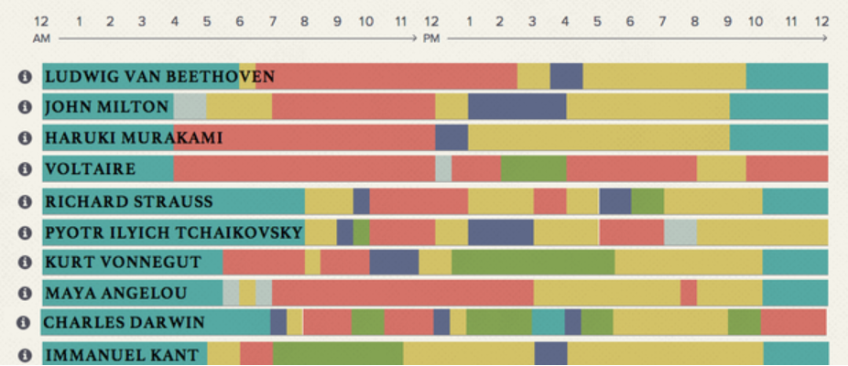
A.1.1 Using interactive infographics in primary education
Examples of Interactive Infographics
1. The Daily Routines of Famous Creative People
Check Infographic on: https://podio.com/site/creative-routines

Slide 19
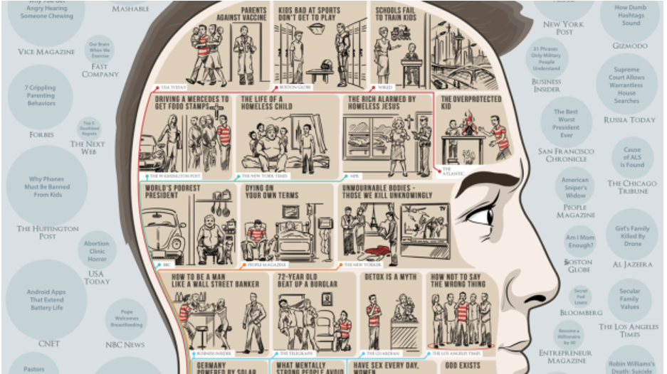
A.1.1 Using interactive infographics in primary education
Examples of Interactive Infographics
2. What The Internet Thinks About
Check Infographic on: https://blog.adioma.com/what-internet-thinks-based-on-media-infographic/

Slide 20
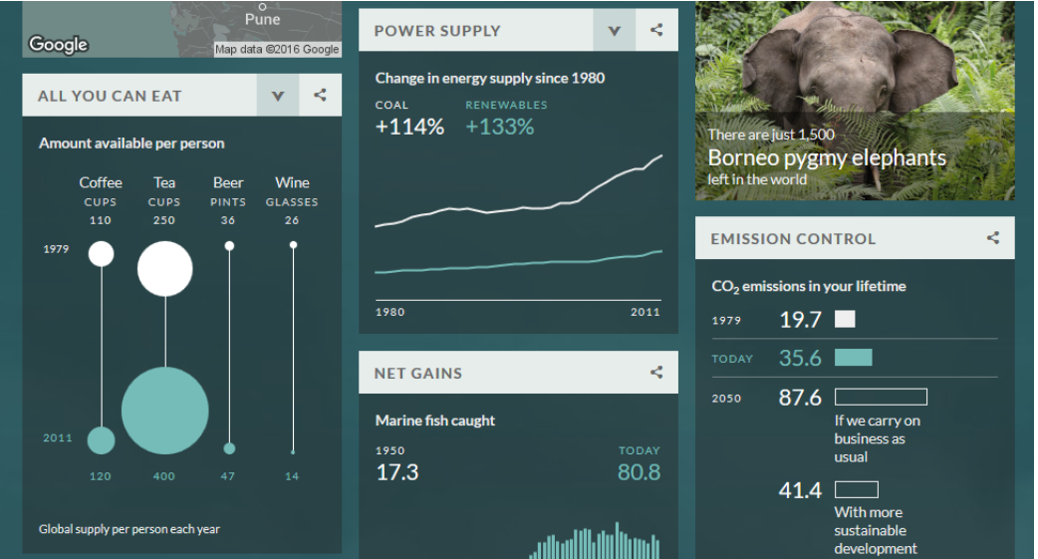
A.1.1 Using interactive infographics in primary education
Examples of Interactive Infographics
3. Your Life On Earth
Check Infographic on BBC: https://bbc-your-life-on-earth.beyondwordsstudio.com/

Slide 21
Task to do 2
Group work
Create 3 groups;
⮚ Work together in each group to sketch as much as you can in 10 minutes, the structure and content of an Interactive Infographic to combat bullying in school;
⮚ Briefly analyse it in your group and emphasize how you think you can use the infographic with your primary schoolers, by arguing on its practical educational value (5 minutes);
⮚ Nominate one member of your group to share the infographic idea and value with the whole class of trainees (5 minutes/group).
Working time: 30 minutes

Slide 22
References
1. Cambridge Dictionary, https://dictionary.cambridge.org/dictionary/english/infographic
2. Oxford Dictionary, https://www.lexico.com/definition/infographic
3. What is an Infographic? Examples, Templates & Design Tips, https://venngage.com/blog/what-is-an-infographic/
4. How to Create an Interactive Infographic: The Definitive Guide, https://rockcontent.com/blog/interactive-infographic/
5. Interactive Infographic, http://www.itvantage.co.uk/services/interactive-infographic
6. 8 Types of Interactive Infographics, https://blog.dot.vu/8-types-of-interactive-infographics/
7. 8 Types of Interactive Infographics, https://blog.dot.vu/8-types-of-interactive-infographics/
8. The 12 Best Types of Interactive Content for Higher Engagement: Infographics, Widgets, & More, https://killervisualstrategies.com/blog/best-types-interactive-content-infographics-design.html
9. 16 Stunning Examples of Interactive Infographics, https://medium.com/visual-stories/16-stunning-examples-of-interactive-infographics-fa7203845cb1

Slide 23
Activity 1.2:
Safe online learning environments in primary education

Slide 24
A.1.2 Safe online learning environments in primary education
When we refer to the online learning environment (OLE), we are referring to the virtual space in which learners participate in the learning experience.
In this process, learners and instructors are emotionally present when they connect with others in an authentic way during the online learning experience.
The virtual classroom is the heart of online learning - a convenient, central place where your lessons unfold. Although there are many fundamental similarities between a traditional classroom-based education and the online learning experience, learning through a virtual classroom offers many benefits that traditional classes don’t provide.
But it is important to learn within safe online environments and define online safety for your pupils, so they can understand what to avoid or report when doing online work for class.

Slide 26
A.1.2 Safe online learning environments in primary education
An Online Learning Environment (OLE) is defined as:
“A learning environment with no physical location and in which the instructors and students are separated by space.”
“Online didactic context that promotes students learning.”
“The environment where teaching and learning take place through the use of computers and the Internet.”
“The virtual learning space where students exchange knowledge and expertise using the virtual classroom.”
“An explicitly represented and designed space for educational interactions, in which students are active in co-constructing the virtual space.”
(IGI Global. What is Online Learning Environment)
Many definitions…with a common perspective!

Slide 27
A.1.2 Safe online learning environments in primary education
Features of online learning environment (1)
Online Learning Environments offers the following (or have the following features):
1. Collaboration of Various Learning Tools
2. Strong Reporting with Customization
3. Natural User Interface
4. Responsive Design Features
5. Availability Features
Notes:
1. Collaboration of Various Learning Tools: Mixed learning resources that you may include while teaching via an online environment enable you to oblige diverse adapting needs and inclinations. You can offer your pupils up close and customized guidance. Also, you can provide them self-guided, web-based learning ways.
2. Strong Reporting with Customization: Online Learning Management Systems (LMS) reports give you a total picture of online pupil’s execution, commitment, and fulfilment evaluations. You can discover how well they are faring amid intelligent activities. View eLearning appraisal scores with the goal that you can suggest supplemental web-based preparing assets, and guarantee that they are getting the data they have to accomplish the ideal results.
3. Natural User Interface: An online course or lesson (i.e. teaching in an online environment) is easy to use and instinctive. It allows you to include an assortment of dashboards that feature distinctive parts of the eLearning process you provide to pupils.
4. Responsive Design Features: As pupils need access to online learning anytime, anyplace, the online learning environment can convey portable inviting substance immediately; it offers everybody a similar survey involvement and gives similar advantages through responsive structure highlights.
5. Availability Features: If you are working with pupils with Special Educational Needs (SEN) and you need to consider availability highlights, online learning environment allows you to include inscriptions and captions to suit pupils who are hearing debilitated or sound portrayals for the individuals who are outwardly hindered; it also allows you to provide useful online assets to pupils worldwide.

Slide 28
A.1.2 Safe online learning environments in primary education
Features of online learning environment (2)
6. Convenience and flexibility
7. High-quality pupil-teacher interactions
8. More pupils can enrol at once
9. Better learning experience
10. More Cost-Effective
Accessibility, lower costs and access to high-quality education from all parts of the world increased the public’s appreciation for online learning environments!
Notes:
6. Convenience and Flexibility: online learning environment offers convenience and flexibility in timings and pace, allowing you to learn in your own time.
7. High-Quality Pupil-Teacher Interactions: allows for better quality interactions between pupils and teacher, because the teacher has various teaching methods at his/her disposal. S/he can focus on individual pupils a lot more than s/he would in traditional classes. It ensures that each pupil gets adequate attention and advice from his/her teacher.
8. More pupils can enrol at once: Online learning classes that depend on pre-recorded videos and tests can have an unlimited number of pupils enrolling, since there’s no need for physical classrooms and seats.
9. Better learning experience: because pupils are allowed to learn at their own pace and are encouraged to gain hands-on experience over memorizing textbooks; it also helps pupils attend classes from places they’re comfortable being in, which makes them more likely to approach learning with a positive attitude, without pressure from commutes, class timings and personal schedules – thus students have more energy to attend online classes.
10. More cost-effective: Online learning is priced lower than traditional learning and is also worth the cost. The fees often don’t account for accommodation, textbooks, equipment, groceries, transport and other factors that contribute to the full learning experience in traditional schooling. Lower costs don’t mean a decrease in quality; lower costs ensure that a wider audience has access to universities and courses that were once reserved for those with higher budgets.

Slide 29
Task to do 3
Whole class work: Discussion
All trainees will participate in a brief discussion around the following questions:
Are you familiar with online learning environments?
Do you teach (have you taught so far) online to your pupils?
Are you aware of what are the types of online learning environments?
Working time: 5 minutes

Slide 31
A.1.2 Safe online learning environments in primary education
Types of online learning environments
Types of OLE are :
E-Learning / online learning
Virtual learning environment
Formal & informal learning environment
Personal learning environment
Social learning environment
Notes:
The Online Learning Environment (OLE) provides helpful resources such as discussion forums, quizzes, eReadings, and the study notes. The online learning environment is primarily an asynchronous environment that is, you don’t have to log on to the computer at exactly the same time as your instructor or classmates in order to attend class. You will however, have specific deadlines to meet for the reading assignments and learning activities.

Slide 32
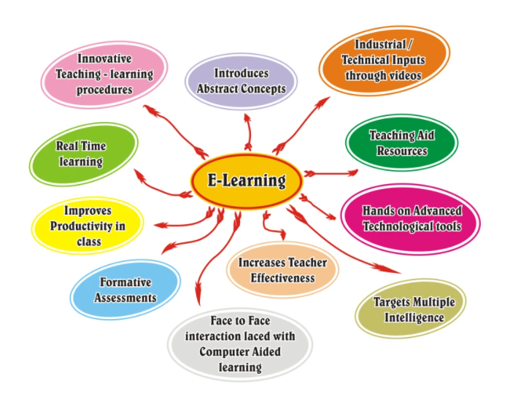
A.1.2 Safe online learning environments in primary education
Types of online learning environments (1)
E-Learning/Online learning environment:
is a learning environment that supported by the use of educational technology or electronic hardware and operating system

Slide 33
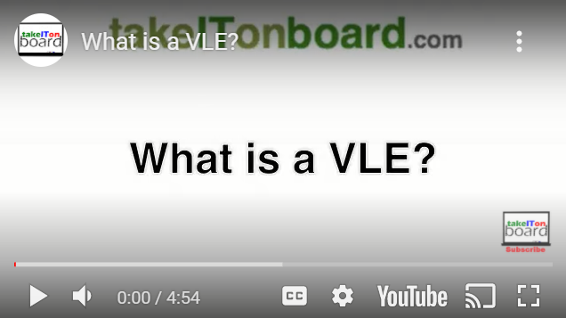
A.1.2 Safe online learning environments in primary education
Types of online learning environments (2)
Virtual learning environment (VLE):
is a set of teaching and learning tools designed to enhance a student’s learning experience by including computers and the Internet in the learning process.
https://youtu.be/MxtNoZqIVxI

Slide 34
A.1.2 Safe online learning environments in primary education
Types of online learning environments (3)
Formal & informal learning environment
Formal Learning Environment is a learning environment where the learning occurs intentionally in an organized and structured environment. In a formal learning environment, the training or learning department sets the goal and objectives.
Informal Learning Environment is a learning environment where the learning occurs unintentionally through persistent and pervasive ongoing phenomena of learning via participation or learning via knowledge creation. Informal learning means the learner sets the goal and objectives.

Slide 35
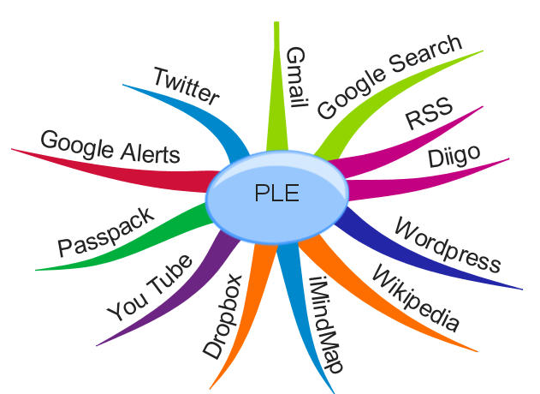
A.1.2 Safe online learning environments in primary education
Types of online learning environments (4)
Personal learning environment (PLE): is a system that help learners take control of and manage their own learning. This includes providing support for learners to:
set their own learning goals ( with support of their teachers)
manage their learning, both content and process
communicate with others in the process of learning

Slide 36
A.1.2 Safe online learning environments in primary education
Types of online learning environments (5)
Social learning environment (SLE): is an online destination where people can come together to co-create content, share knowledge, and learn from one another. It combines social elements like networking, tagging, file sharing, and microblogging to create a safe space in which to work and learn collaboratively.
It integrates key social media technologies to provide the necessary social tools for collaboration and information sharing.
It should provide an open, collaborative environment where individuals are not “managed” or “controlled” but rather “supported” in their working and learning.

Slide 37
A.1.2 Safe online learning environments in primary education
Types of online learning
Online learning is a comprehensive term that includes a number of instructional environments and approaches. There are the 10 different types of online/e-learning:
1. Computer Managed Learning (CML) | 6. Adaptive E-Learning
2. Computer Assisted Instruction (CAI) | 7. Linear E-Learning
3. Synchronous Online Learning | 8. Interactive Online Learning
4. Asynchronous Online Learning | 9. Individual Online Learning
5. Fixed E-Learning | 10. Collaborative Online Learning
Notes:
The trainer may find and share with trainees more information about each of the 10 types of online learning here: https://e-student.org/types-of-e-learning/ .

Slide 38
A.1.2 Safe online learning environments in primary education
Examples of online learning environments (1)
When we refer in this context to online learning environment we mean eLearning platforms. Examples:
1. DOCEBO is a collaborative learning platform mostly use in formal learning. It is fully customizable and easy to use, thus popular among students, who use it to interact amongst themselves.
2. Google Classroom: part of the educational G Suite, it comes with a variety of different tools for school environment. From creating content to grading it, this platform has it all. It comes with integrated Slides, Gmail, Calendar, Sheets, Docs, etc.
3. Blackboard Learn: it is an LMS for education (primary users include schools, universities, governments). The cloud-based data storage system ensures is responsive, mobile-friendly and suitable for editing content from third-party providers.

Slide 39
A.1.2 Safe online learning environments in primary education
Examples of online learning environments (2)
The world's most popular Learning Management System (LMS) is MOODLE.
MOODLE is free and enables educators to create their own private website filled with dynamic courses that extend learning, any time, anywhere.
Moodle can meet the needs of teachers, pupils or administrators.
Moodle's extremely customisable core comes with many standard features.
Notes:
The trainer may find and share with trainees more information about MOODLE here: https://docs.moodle.org/311/en/Features

Slide 41
A.1.2 Safe online learning environments in primary education
Efficient ways to engage pupils in an online learning environment (1)
Teachers face the challenge to keep their pupils motivated and engaged during online learning activities.
In an age of effervescent change in technology, it can be difficult for educators to keep up with the variety of ways to engage pupils in the online classroom.
An additional consideration is engaging pupils with disabilities, which can provide an extra level of difficulty for effective instruction in online environments.
There are easy to implement strategies that educators can utilize in an online format that provide effective and inclusive formats for engaging all pupils.

Slide 42
A.1.2 Safe online learning environments in primary education
Efficient ways to engage pupils in an online learning environment (2)
Here there are five interactive online engagement strategies:
1. Animated response
2. Cooperative learning
3. Organizational outlets
4. Movement
5. Interactive lessons
Notes:
Animated response: Sites such as Voki, PowToon and StoryBird are examples of online platforms that allow students to respond to content in an interactive manner through the creation of a voice-over character, cartoon, or creative story-telling.
Cooperative learning: Cooperative learning (e.g. through think/pair/share, jigsaw and flexible grouping) requires that all group members have specific, designated tasks to complete, and without each group member’s contribution the work is incomplete. Platforms that can support this: Edublogs, Weebly for education, Zoom breakout rooms, or a shared Google document.
Organizational outlets: All students benefit from organizing their learning. Graphic organizers (e.g. Freeology.com, Canva.com, Microsoft, Google and EndNote) assist students in conceptualizing and chunking out the material being learned and helps maintain a clear focus of what needs to be dissected from the information.
Movement: By intentionally incorporating movement into instruction, engagement can become more achievable. Four corners learning is one strategy that can encourage student movement. In an online environment this would be done through the incorporation of a GoNoodle activity, or simply having the teacher walk students through movements together with their directive during a transition.
Interactive learning: Teachers can also embed interactive learning opportunities for students in PowerPoints through the PearDeck add-on for Google Slides or NearPod where students can interact with learning content through questions, surveys, or specific student responses.

Slide 43
A.1.2 Safe online learning environments in primary education
Advice for teachers on how to better engage their pupils during online classes:
Be present Create interesting learning materials Provide 1-to-1 sessions Assign some group work Create an online forum for discussions Provide and ask for a regular feedback Challenge pupils | 8. Make online classes more interactive 9. Use multiple formats 10. Offer active learning opportunities 11. Take help of gamification 12. Give opportunities for self-assessment 13. Instructors should be trained in online teaching 14. Use diverse delivery medium | 15. Update the content regularly 16. Assign success coaches 17. Encourage accountability 18. Nurture intrinsic motivation 19. Have good technical support 20. Have positive environment 21. Have active communication

Slide 44
Task to do 4
Individual / Group work:
Seeing and critiquing peer work through virtual gallery walks
Perform the task described in Annex 1.2
Working time: 40-45 minutes

Slide 45
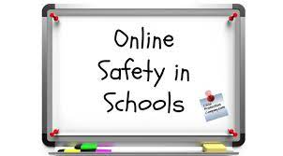

Slide 46
A.1.2 Safe online learning environments in primary education
About online safety
It is important to define online safety for pupils so they can understand what to avoid or report when doing online work for class.
This knowledge gives pupils what they need to build responsible online behaviors for the future.
It also shows them how to behave responsibly and cautiously online, which will help them stay safe on the internet even when they’re not doing classwork.

Slide 47
A.1.2 Safe online learning environments in primary education
How to create safety online environments for your pupils
Define online safety
Prevent unwanted access
Prevent unwanted contact
Prevent unwanted exposure

Slide 48
A.1.2 Safe online learning environments in primary education
How to define online safety to your pupils
Create assignments and activities about online safety!
Encourage parental involvement!
Provide students with resources (e.g. videos about being safe online)!
Be available to talk!
Install monitoring software on school-issued laptops!

Slide 49
A.1.2 Safe online learning environments in primary education
How to prevent unwanted access
Not all available online content are appropriate. Pupils may be exposed to sites with pornography, gruesome images, violence, and other inappropriate content. Your pupils can also end up at unsafe sites through innocent search results or by clicking links to supposedly safe videos. Keep online learning appropriate by:
Establishing limits (tell pupils about the sites they can or cannot visit and explain why)
Doing a quick check (make sure that the sites your pupils visit are age-appropriate)
Using control (most browsers have a built-in filter to ensure that only kid-friendly search results show up)
Establishing open communication (when your pupils are accidentally exposed to inappropriate sites, initiate a conversation to discuss the issues and concerns they may have with the material).

Slide 50
A.1.2 Safe online learning environments in primary education
How to prevent unwanted contact
Pupils can easily socialize with their friends or make new ones online. But online socializing can have risks, particularly cyberbullying or online grooming. Keep online contact of the pupils friendly but safe:
Be nice: Tell your pupils to treat people online the way they would want to be treated. Encourage them to only befriend people they know in real life.
Report any incident of harassment: Instruct your pupils to tell about any interaction that makes them feel uncomfortable or harassed.
Show interest: Find out who your pupils talk to online. Ask details about their online friends. This lets you track if any suspicious activity is going on.
Use technology: Monitoring software can help keep tabs on your pupil’s activities.
Notes:
Cyberbullying refers to the act of harassing someone through information technology.
Online grooming is a way for online predators to victimize unsuspecting children. Sexual predators may attempt to befriend children online through flattery, sympathy, or gifts.

Slide 51
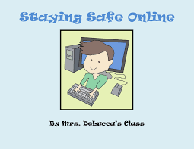

Slide 52
A.1.2 Safe online learning environments in primary education
How to prevent unwanted exposure
Pupils may not be aware that whatever they share online could wind up public and have undesirable consequences. Teach pupils to keep shared information private:
Check privacy policies
“Think before you post”
Review mobile apps
Double-check your security (use privacy scanning software)

Slide 53
A.1.2 Safe online learning environments in primary education
How to keep it safe
Not only teachers/school but also parents should make sure that their kids are exposed to the right type of material.
There are several resources made especially for that:
Internet Safety for Kids and Family (https://www.trendmicro.com/internet-safety/ )
Internet Safety @ Home (https://www.trendmicro.com/en_us/initiative-education/internet-safety-kids-families.html )
Digital Life e-Guides (https://www.trendmicro.com/vinfo/us/threat-encyclopedia/ )

Slide 54
References (1)
1. IGI Global, What is Online Learning Environment, https://www.igi-global.com/dictionary/interacting-at-a-distance/21004
2. Top 10 eLearning Features That Everyone Should Know About, https://elearningindustry.com/elearning-features-top-everyone-know
3. Online Learning Is The Future Of Education: Here’s Why, https://elearningindustry.com/why-online-learning-is-future-of-education
4. Innovate Learning Environment, https://fahiezan.wordpress.com/week-3/
5. All 10 Types of E-Learning Explained, https://e-student.org/types-of-e-learning/
6. 10 Best Examples of eLearning Platforms Today, https://axiomq.com/blog/10-best-examples-of-elearning-platforms-today/
7. MOODLE, https://docs.moodle.org/311/en/Features
8. Five Ways to Engage Students in an Online Learning Environment, https://www.facultyfocus.com/articles/online-education/online-course-delivery-and-instruction/five-ways-to-engage-students-in-an-online-learning-environment/

Slide 55
References (2)
9. 10+ New Ideas for Increasing Student Engagement in Online Courses, https://www.digitalclassworld.com/blog/how-to-engage-students-online/
10. Maintaining A Safe Learning Environment for Distance Learning, https://learnsafe.com/maintaining-a-safe-learning-environment-for-distance-learning/#:~:text=It%20is%20important%20to%20define,online%20behaviors%20for%20the%20future
11. Creating a Safe Online Environment for Kids, https://www.itu.int/en/cop/Documents/Creating%20a%20Safe%20Online%20Environment%20for%20Kids%20ITU.pdf

Slide 56
Activity 1.3:
Creating digital lesson plans to use interactive infographics in primary education

Slide 57
A.1.3 Creating digital lesson plans to use interactive infographics in primary education
What is the Sticks’n’Stones “Toolkit of Interactive Infographics Resources to Combat Bullying” (1)
This Toolkit has been elaborated by the consortium of the Sticks’n’Stones project.
The Toolkit is a complete set of 35 interactive, digital pedagogic resources that primary teachers can use in the classroom with pupils to raise awareness of and address bullying in their school.
These resources are presented as a set of posters, with links to digital resources and activities embedded in the poster, through QR codes. They are called Interactive Infographics (Interactive Infographics have been presented in Activity 1.1 of this document).

Slide 58
A.1.3 Creating digital lesson plans to use interactive infographics in primary education
What is the Sticks’n’Stones “Toolkit of Interactive Infographics Resources to Combat Bullying” (2)
The activities included in these digital resources (Interactive Infographics) aim to build the knowledge, vocabulary and awareness of pupils about bullying and cyberbullying.
They also support pupils to build their resilience to maintain their sense of self and wellbeing, even when faced with bullying.
Due to the nature of the posters, with embedded digital activities, these Interactive Infographics can also be used outside of the classroom to promote key messages to address instances of bullying in schools.
As such, they will be displayed in the hallways of schools, so that pupils can access the videos and digital resources and gain support, at break-times and outside of the formal classroom sessions.

Slide 59
A.1.3 Creating digital lesson plans to use interactive infographics in primary education
What is the Sticks’n’Stones “Toolkit of Interactive Infographics Resources to Combat Bullying” (3)
The Sticks’n’Stones Interactive Infographics are comprised of digital resources that are embedded into an Infographic poster through the use of QR codes.
If you click on the QR codes in this Infographic, you will find a range of digital learning materials including:
- educational videos (presented as animations/cartoons for pupils)
- digital breakouts
- games
- quizzes and then
- group-based activities
that are presented in the format of WebQuests.

Slide 60
A.1.3 Creating digital lesson plans to use interactive infographics in primary education
What is the Sticks’n’Stones “Toolkit of Interactive Infographics Resources to Combat Bullying” (4)
The Sticks’n’Stones Infographics are designed to be used in a classroom setting, with teams of pupils completing the challenges, quizzes and activities, to develop a combined understanding of school bullying, and to resolve to tackle instances of bullying together.
Each Sticks’n’Stones Interactive Infographics contains the following 4 elements:
1. An introductory video
2. A quiz or puzzle
3. A Digital Breakout
4. WebQuest

Slide 61
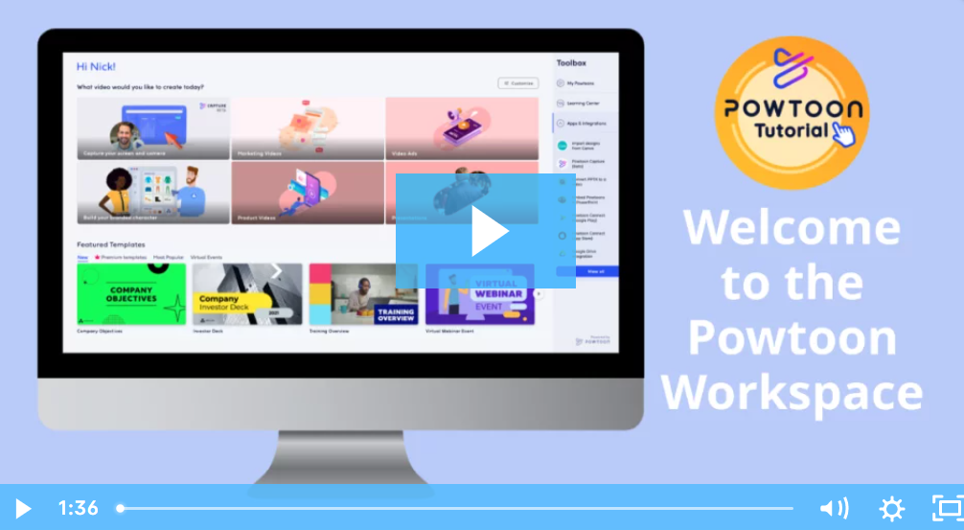
A.1.3 Creating digital lesson plans to use interactive infographics in primary education
What is the Sticks’n’Stones “Toolkit of Interactive Infographics Resources to Combat Bullying” (5)
1. The introductory videos: built using Powtoon, these videos will introduce the topic and the key learning content of the interactive infographics. Here pupils will be introduced to key terms and important messages that will help to provide a context to the learning activities that will follow.

Slide 62
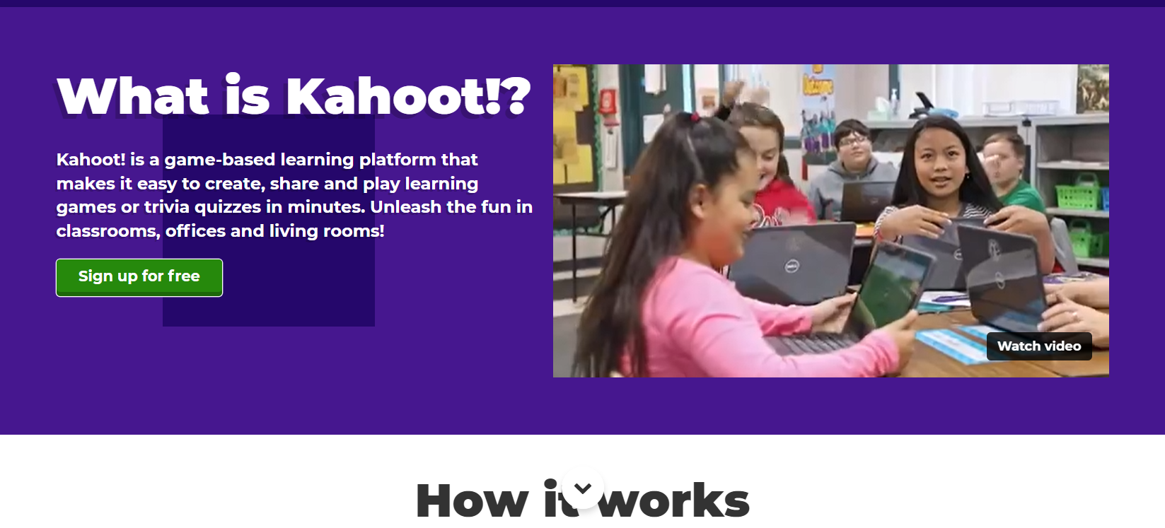
A.1.3 Creating digital lesson plans to use interactive infographics in primary education
What is the Sticks’n’Stones “Toolkit of Interactive Infographics Resources to Combat Bullying” (6)
2. The quiz or puzzle: developed using KAHOOT, these quizzes and puzzles will test the pupils to define and match key terms introduced in the introductory video. These quizzes will help to reinforce there learning from the video.

Slide 63
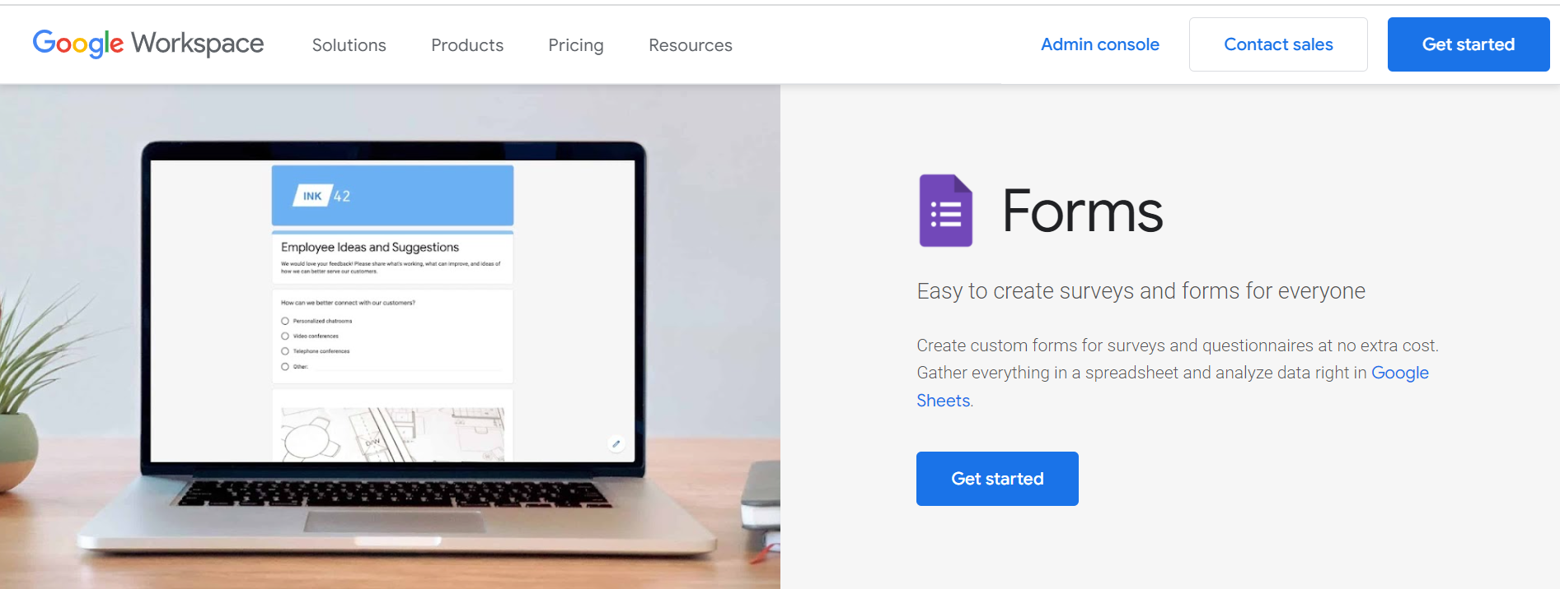
A.1.3 Creating digital lesson plans to use interactive infographics in primary education
What is the Sticks’n’Stones “Toolkit of Interactive Infographics Resources to Combat Bullying” (7)
3. The Digital Breakout: developed using Google Forms or Google Sites, these challenge-based learning resources will have a minimum of 3 challenges linked to the topic of the infographic. These challenges may include picture games (for naming emotions associated with bullying), word searches (to build vocabulary), self-reflection questions (to evaluate behaviour).

Slide 64
A.1.3 Creating digital lesson plans to use interactive infographics in primary education
What is the Sticks’n’Stones “Toolkit of Interactive Infographics Resources to Combat Bullying” (8)
4. The WebQuest: is developed as a branded Word document that can be linked online through the project platform and built using a combination of open source educational software. These WebQuests will be designed as a series of small group or team activities, where pupils will work together to address the topic of the infographic and to develop a poster to raise awareness of bullying, or design an anti-bullying charter for their school, for example. These WebQuests will help to empower pupils to work independently together to build the awareness and self-confidence they need to tackle instances of bullying in their school.

Slide 65
A.1.3 Creating digital lesson plans to use interactive infographics in primary education
What is the Sticks’n’Stones “Toolkit of Interactive Infographics Resources to Combat Bullying” (9)
The 35 Interactive Infographics of the Sticks’n’Stones Toolkit have been developed for 5 areas (5 infographics per area), namely:
1. Bullying 101
2. Besties and Frenemies
3. Don’t be mean behind your screen
4. How bullying affects me and my school
5. A world without bullies

Slide 66
A.1.3 Creating digital lesson plans to use interactive infographics in primary education
What is the Sticks’n’Stones “Toolkit of Interactive Infographics Resources to Combat Bullying” (10)
1. Bullying 101 – these resources introduce pupils to what bullying is and what it is not, the different types of bullying, the roles involved in bullying and what they should do if they see a peer being bullied, or if they are victims of bullying themselves.
2. Besties and Frenemies – these resources teach pupils that it is okay to not be best friends with everyone in class, but that in order to have a safe and happy school environment, they need to have respect for one another and be kind to one another.
3. Don’t be mean behind your screen – these resources aim to reinforce the message that if you wouldn’t feel happy to say it to someone’s face, you shouldn’t be saying it or sharing it online.

Slide 67
A.1.3 Creating digital lesson plans to use interactive infographics in primary education
What is the Sticks’n’Stones “Toolkit of Interactive Infographics Resources to Combat Bullying” (11)
4. How bullying affects me and my school – these resources look at the short- and long-term impact that bullying can have on young people and how it can impact the overall wellbeing in the school community. These resources will address some of the negative thoughts and feelings that people can have about themselves when they are being bullied or cyberbullied, or both, and why it is harmful for others to engage in any type of bullying.
5. A world without bullies – these resources ask pupils to imagine a world without bullying, and to think of ways that they could help their school to eradicate bullying once and for all.

Slide 68
Task to do 5
Group work:
Hands-n session with Sticks’n’Stones Interactive Infographics
⮚ Split in groups of 3-5 trainees (the trainer will organize the groups)
⮚ Access the Sticks’n’Stones Toolkit at: link to be included here!
⮚ Find the infographic indicated by trainer for your group (the trainer will allocate a different infographic for each group)
⮚ Go through the infographic and think how you would implement it with your pupils
⮚ While you go, discuss with peers in your group, share impressions and exchange ideas on how to conduct the class based on the content of that infographic
⮚ Write down within your group 3 strong points of the infographic (or 3 aspects that you liked the most) and 3 suggestions for its improvement, if any.
Working time: 20 minutes
⮚ Share your strong points and suggestions with the whole class; deepen the discussion on the value of Sticks’n’Stones Toolkit
Working time: 15 minutes

Slide 69
A.1.3 Creating digital lesson plans to use interactive infographics in primary education
How to make interactive infographics with Canva
Canva is one of the free technologies for teachers.
One of the many neat things that you can do with Canva is create Interactive Infographics. You can use nearly any design template in Canva to create Interactive Infographics.
Adding some hyperlinked elements to an infographic is a good way for pupils to make the sources of their information readily accessible to viewers. Using the linking tool could also be a good way for pupils to provide additional information about the key points that they emphasize in their graphics.

Slide 70
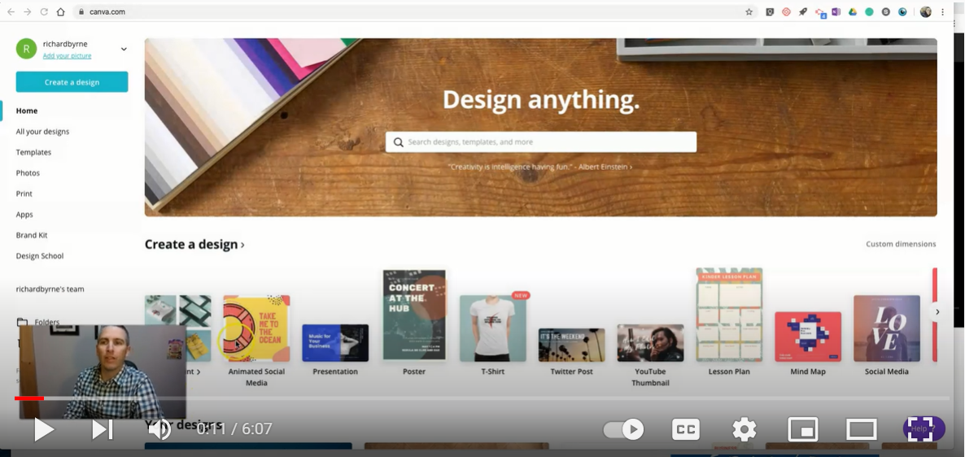
Task to do 6
Whole class work:
⮚ Watch the video at the link: https://www.youtube.com/watch?v=2csQTdfrctk to find out how make an Interactive Infographic with Canva.
⮚ Brainstorm with the whole class on the ideas of using Canva to design Interactive Infographics and write ideas on sticky notes about strong points on the value of Canva-designed infographics for teachers/education.
Working time: 15 minutes

Slide 71
A.1.3 Creating digital lesson plans to use interactive infographics in primary education
How to design digital lesson plans by using Lesson Plan Canvas and include Interactive Infographics from Sticks’n’Stones Toolkit and other digital learning resources (1)
With Canva is possible to create many types of resources, as it offers a large variety of templates for: presentations, videos, infographics, wall calendars, photo collages, book covers, mind maps, posters, lesson plans and many more.
Templates can be combined, personalised/customised and various information may be included, thus to meet the purpose and educational interests of the creator.
The Lesson Plan Canva is based on the Business Model Canva, but it has been adapted to be applied to a primary teaching session, and it is an effective tool for integrating technology into the classroom.

Slide 72
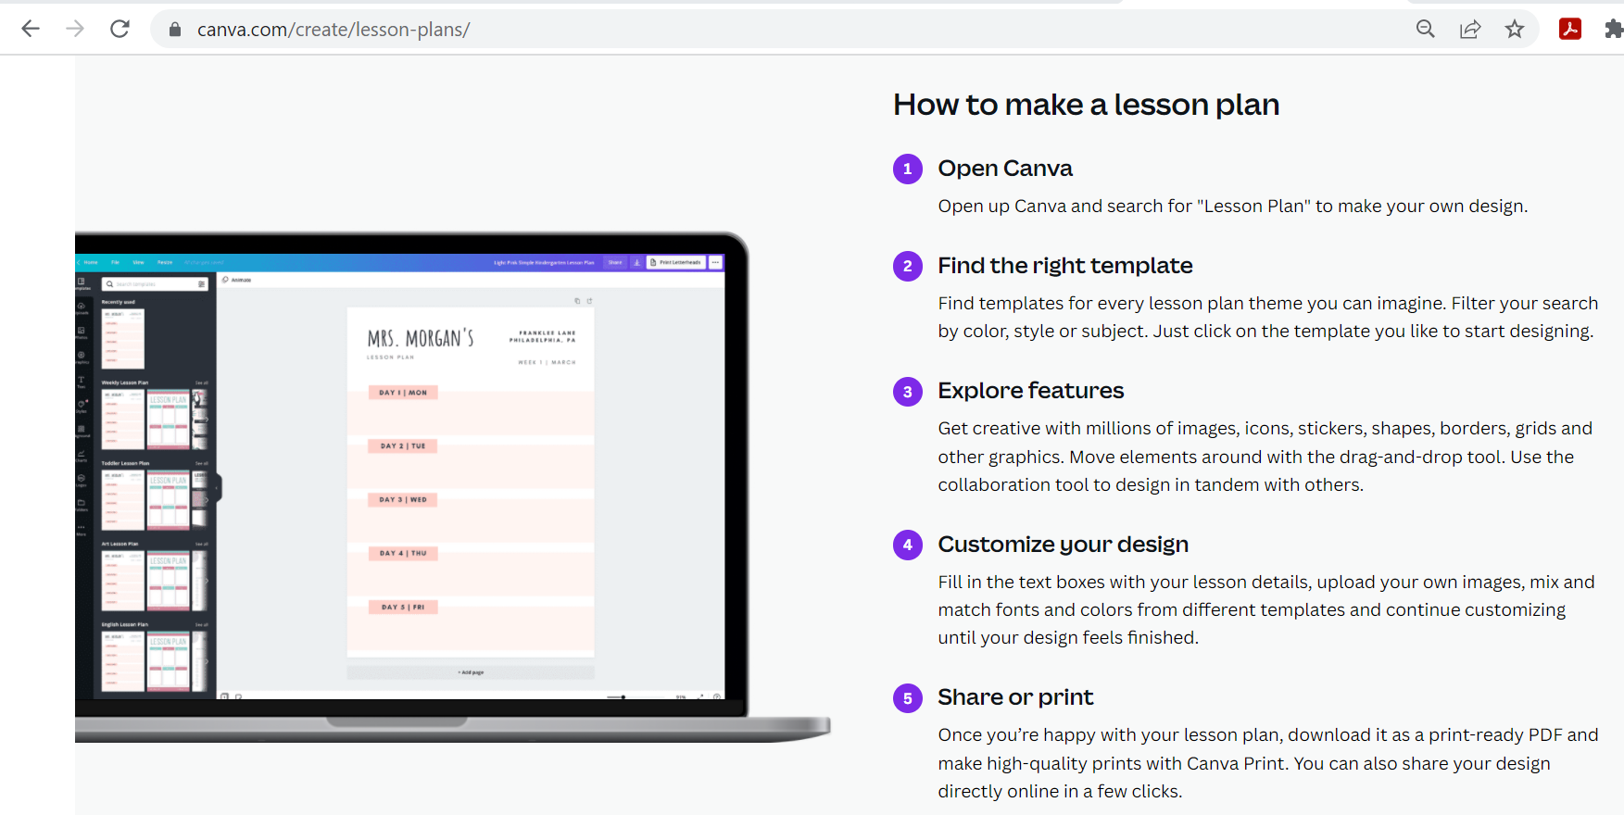
A.1.3 Creating digital lesson plans to use interactive infographics in primary education
Canva teaches you in 5 steps how to make a lesson plan with its templates!

Slide 73
A.1.3 Creating digital lesson plans to use interactive infographics in primary education
How to design digital lesson plans by using Lesson Plan Canvas and include Interactive Infographics from Sticks’n’Stones Toolkit and other digital learning resources (2)
Each of the 35 Interactive Infographics in the Sticks’n’Stones Toolkit are accompanied by a Teacher Handbook. They include useful information for how the activities in the Interactive Infographics can be delivered in a classroom setting in primary schools. REMEMBER:
Interactive Infographics from Sticks’n’Stones Toolkit
Teachers Handbooks from Sticks’n’Stones Toolkit
Canvas Lesson Plan Templates from https://www.canva.com/
represent a valuable package of educational resources at your hand, for designing and implementing efficient and attractive digital lessons to use in the classroom with your pupils, to raise awareness of and address bullying in their school!

Slide 74
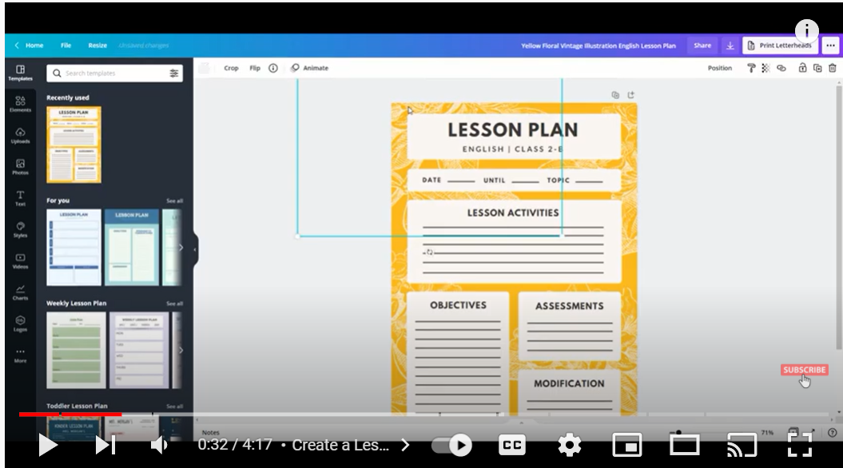
Task to do 7
Whole class work:
⮚ Watch the tutorial on how to make a
lesson plan with Canva at the link:
https://www.youtube.com/watch?v=bt4M2_f9lwY
Individual work:
⮚ Access Canva website at: https://www.canva.com/
⮚ Chose a lesson plan template and sketch your own lesson plan on ‘combat bullying in primary schools’
⮚ Include in your lesson plan one Interactive Infographic from Sticks’n’Stones Toolkit and add at least one other digital learning resources (e.g. video, mind map, H5P exercise, etc.)
⮚ At the end, the trainer will nominate few trainees and ask them to present their lesson plans. All trainees will be provide feedback and will be engaged in discussions
Working time: 40 minutes

Slide 75
References
1. Sticks’n’Stones Toolkit, link to be added here!
2. Powtoon, https://www.powtoon.com/?locale=en
3. Kahoot, https://kahoot.it/
4. Google Workspace, https://workspace.google.com/
5. Canva, https://www.canva.com/
6. How to make interactive infographics with Canva, https://www.freetech4teachers.com/2019/12/how-to-make-interactive-graphic-with.html
7. How to make a lesson plan, www.canva.com/create/lesson-plans/
8. Canva Tutorial for Teachers | Create a Lesson Plan on Canva, https://www.youtube.com/watch?v=bt4M2_f9lwY

Slide 76
Thank you for attention!

Slide 77
"The European Commission's support for the production of this publication does not constitute an endorsement of the contents, which reflect the views only of the authors, and the Commission cannot be held responsible for any use which may be made of the information contained therein.”
Project Number:

